Slide 1
Lecture 5: Large Language Model API and Coding
Instructor: Zhanzhan Zhao

Slide 2
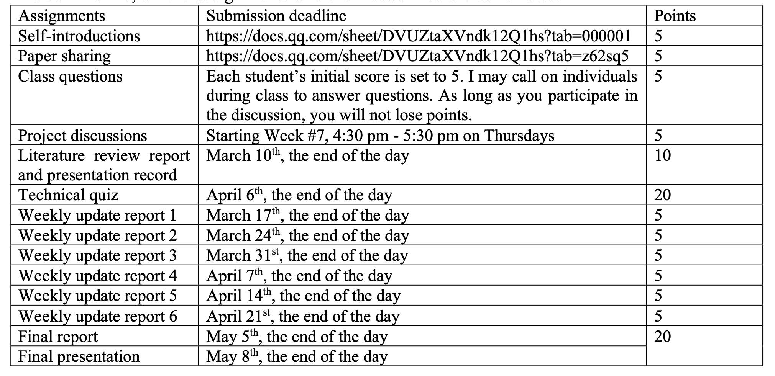
Logistics – Class Assessment Scheme

Slide 3
Recap

Slide 4
Various LLMs
GPTs, Deepseek
Llama (Meta)
Q: Llama 3 405B, how many parameters? Performance?
Q: During pre-training, what kind of web data gets removed from training dataset?
Q: During pre-training, what kinds of quality classifiers are used?
Q: During pre-training, what kind of data is specially collected?
Q: What is the data mix percentage used for training?
Q: What does “annealing the learning rate” mean?
Q: What does “Scaling laws” mean in ML?
Qwen
Q: What is Qwen’s context length?

Slide 5
API Usage
API Pricings
Model Performances
6 API Usage example codes

Slide 6
Accessing GPT API
ChatGPT API key: https://platform.openai.com/account/api-keys
Advantages
Batch processing
Disadvantages
Foreign credit card for payment
Direct access is unavailable in China
25
25

Slide 7
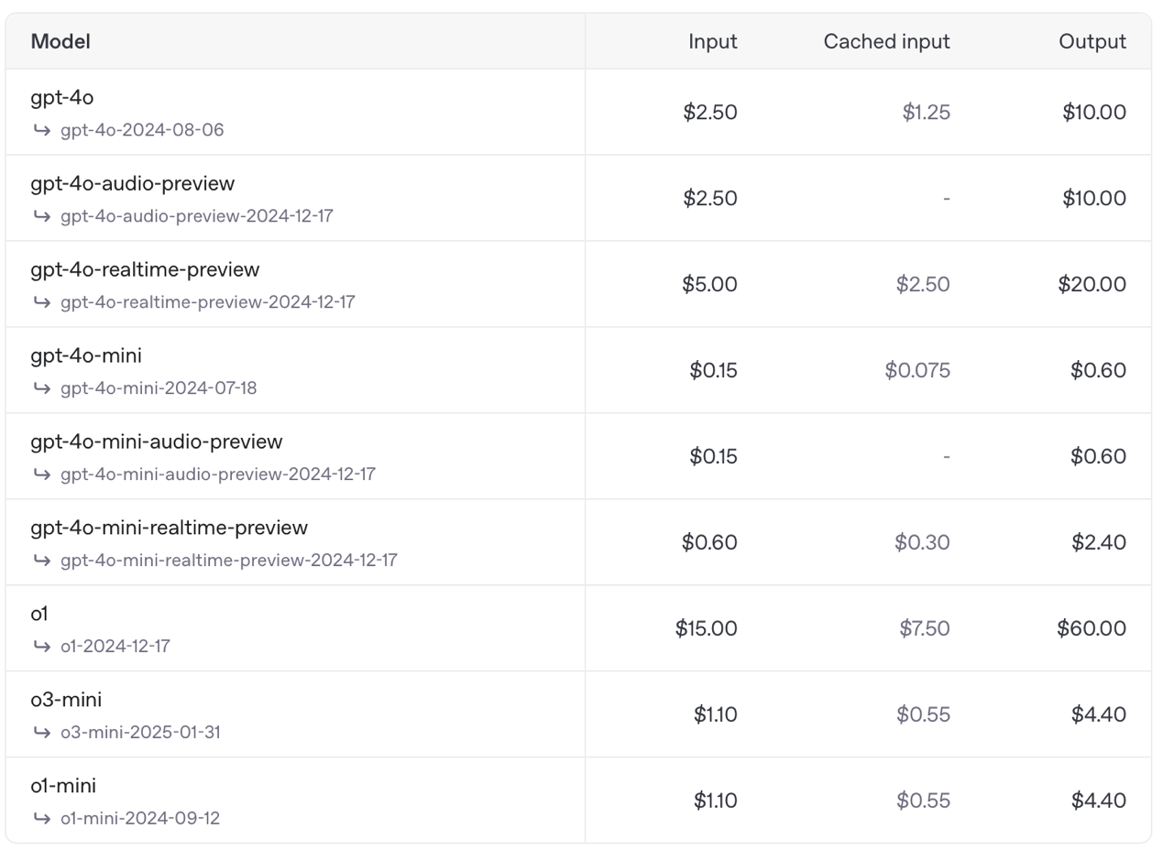
ChatGPT API

Slide 8
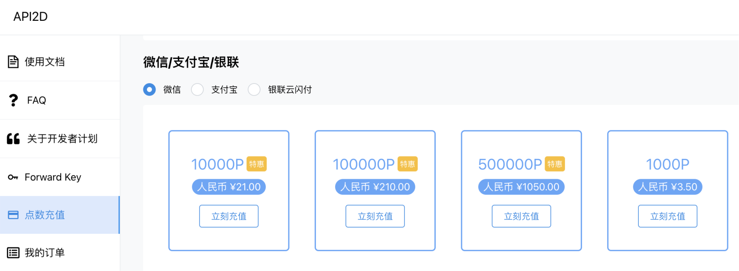
Accessing GPT API in China - API2D
Domestic API: https://api2d.com/
1.5X Price on OpenAI
29
29

Slide 9
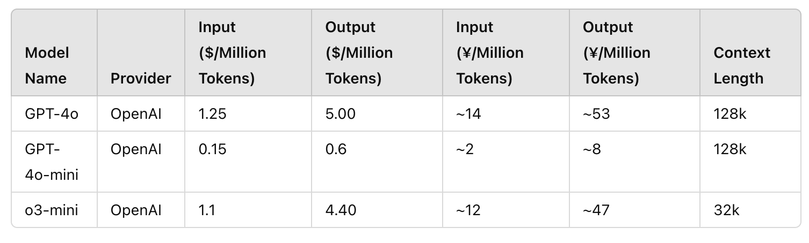
Accessing GPT API in China - API2D
Domestic API: https://api2d.com/
1.5X Price on OpenAI
29
29

Slide 10
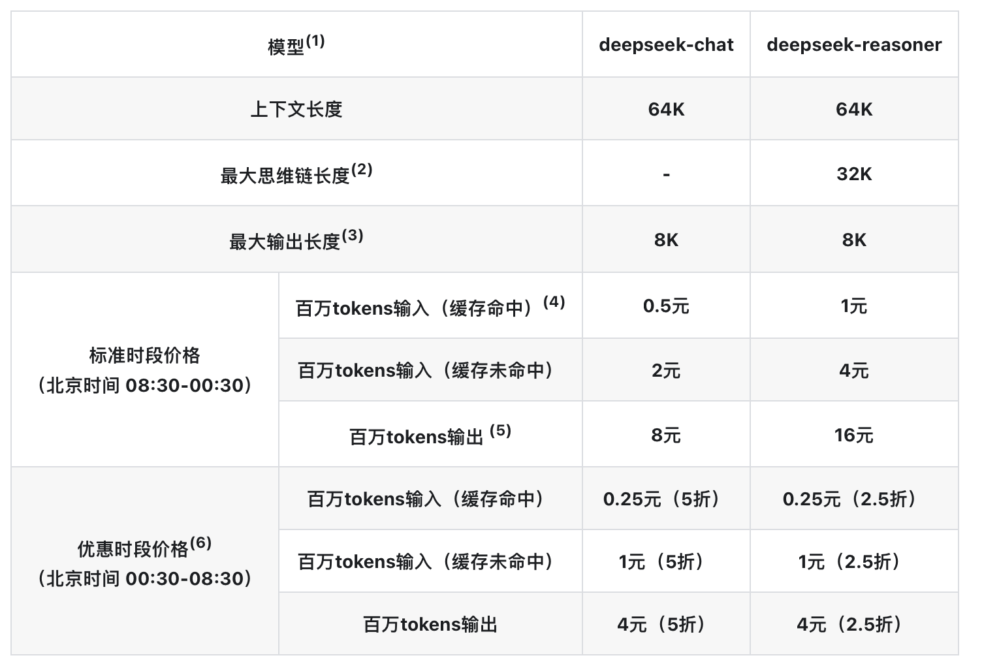
Deepseek API
https://api-docs.deepseek.com/zh-cn/quick_start/pricing
Cache Hit: The data is in the cache, and access is fast.
Cache Miss: The data is not in the cache, and it needs to be retrieved from main memory or another storage, resulting in slower access.

Slide 11
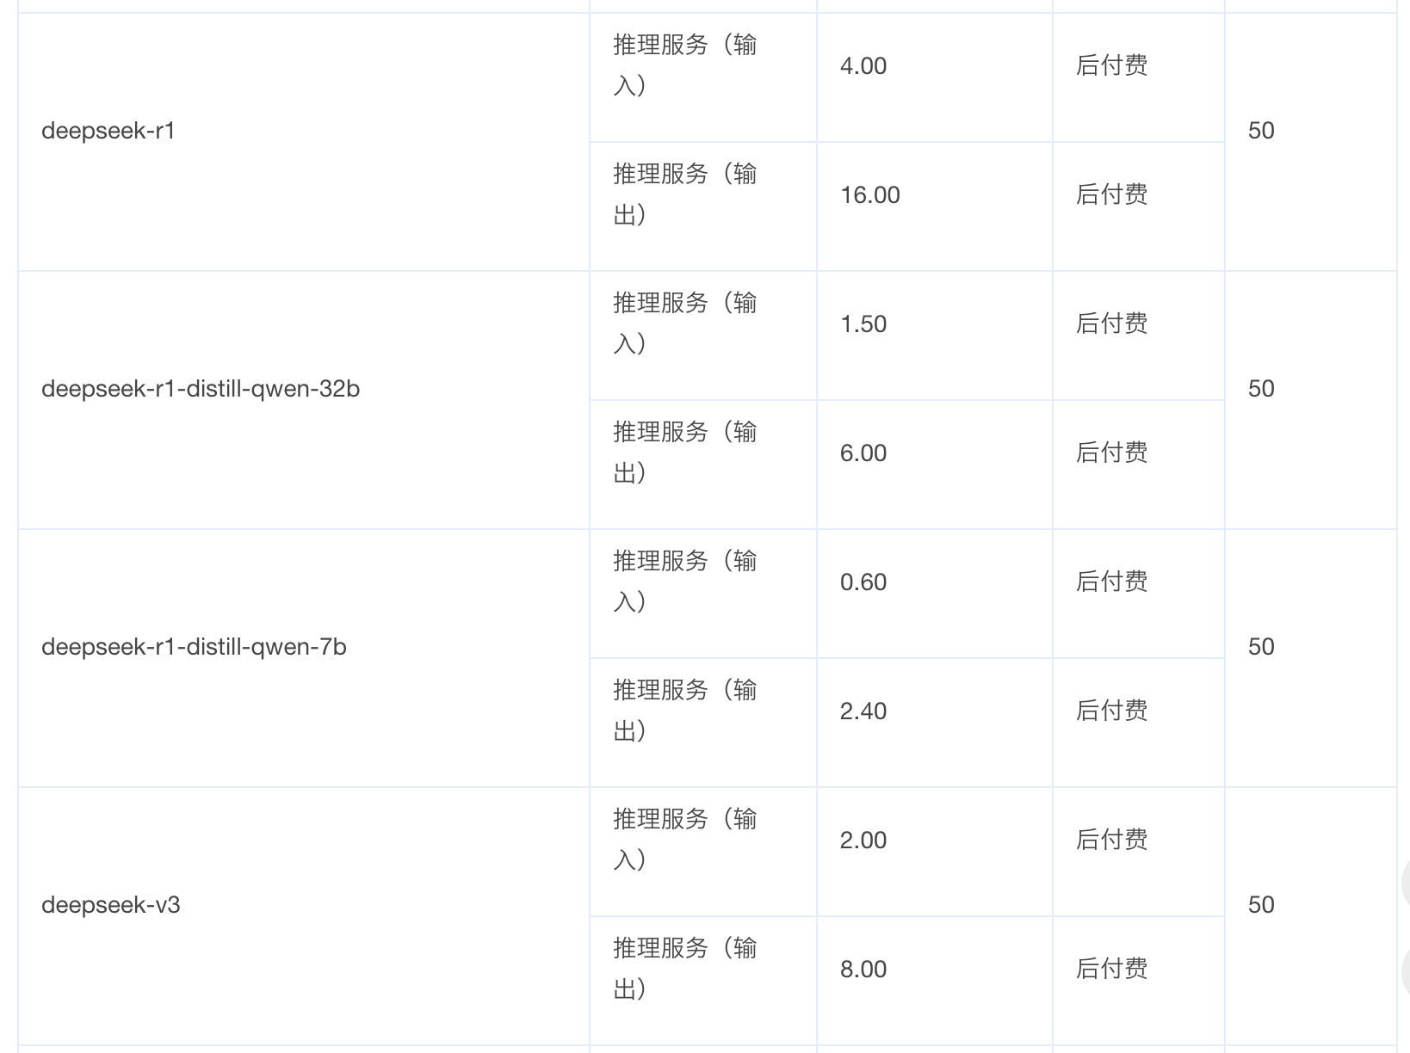
Deepseek API 火山引擎
https://www.volcengine.com/docs/82379/1449737
First 500k tokens free
Cache Hit: The data is in the cache, and access is fast.
Cache Miss: The data is not in the cache, and it needs to be retrieved from main memory or another storage, resulting in slower access.

Slide 12
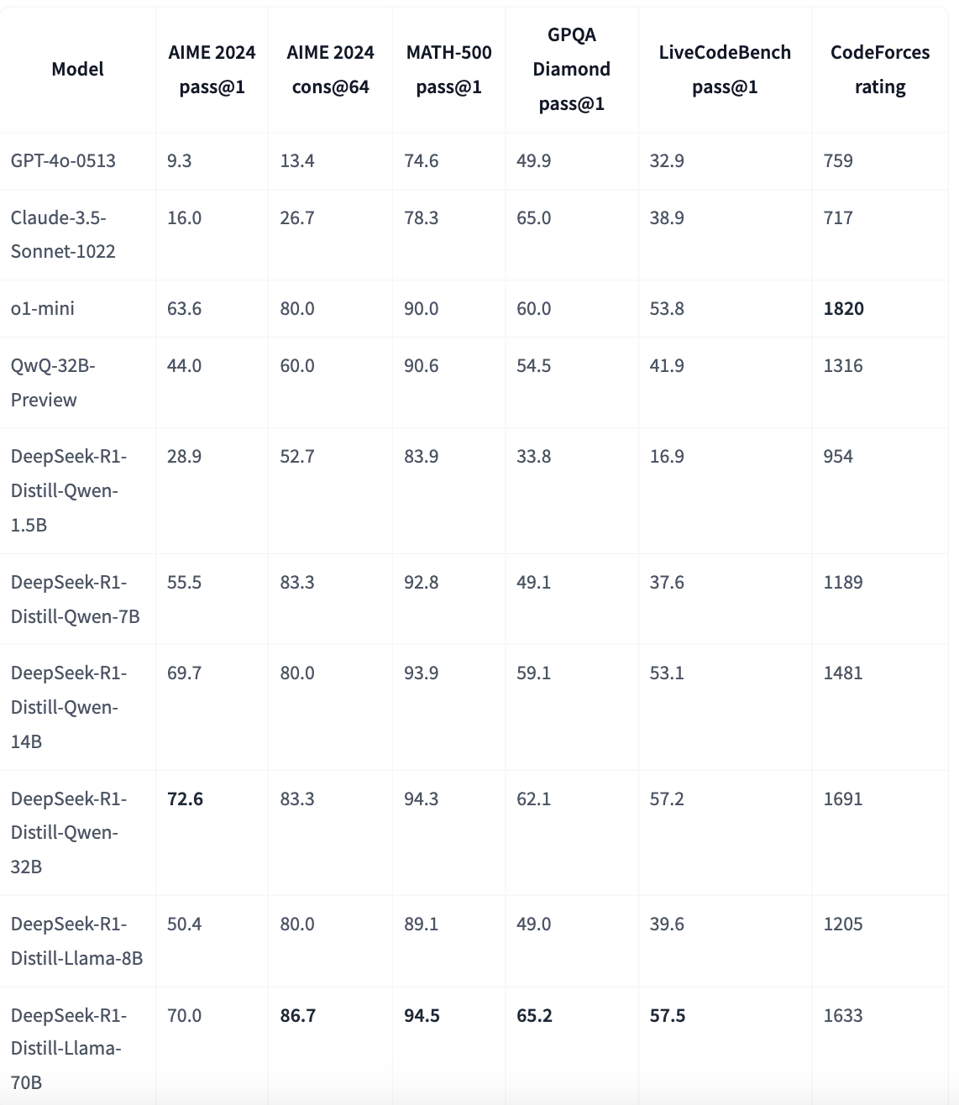
Distilled Models
Distilled model evaluation: https://huggingface.co/deepseek-ai/DeepSeek-R1-Distill-Qwen-32B?utm_source=chatgpt.com

Slide 13
Distilled Models
Knowledge Transfer: Distilled models learn to replicate the behavior of larger models by training on the outputs of the teacher model, effectively capturing its knowledge and capabilities. en.wikipedia.org
Enhanced Efficiency: By reducing the model size, distilled LLMs require less computational power and memory, making them more suitable for deployment in resource-constrained environments. datacamp.com
Improved Performance: Distillation can lead to models that not only perform well on specific tasks but also generalize better across various applications, often outperforming traditional smaller models trained from scratch. arxiv.org
Practical Applications: Distilled LLMs are particularly useful in scenarios where deploying large models is impractical, such as on mobile devices, in real-time applications, or in situations with limited computational resources.

Slide 14
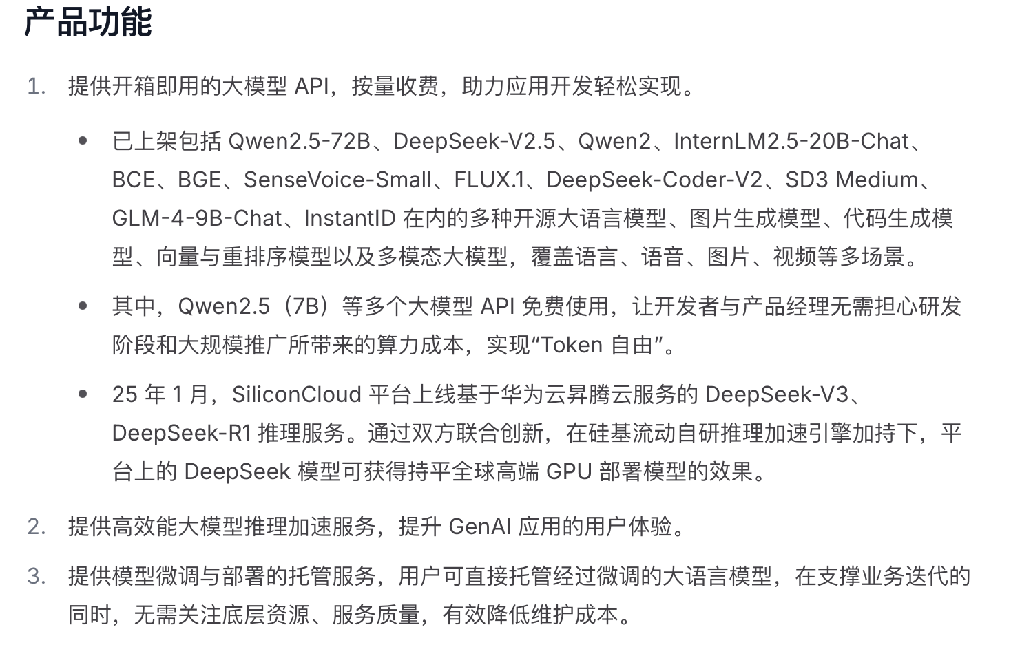
Deepseek API 硅基流动
https://docs.siliconflow.cn/cn/api-reference/chat-completions/chat-completions

Slide 15
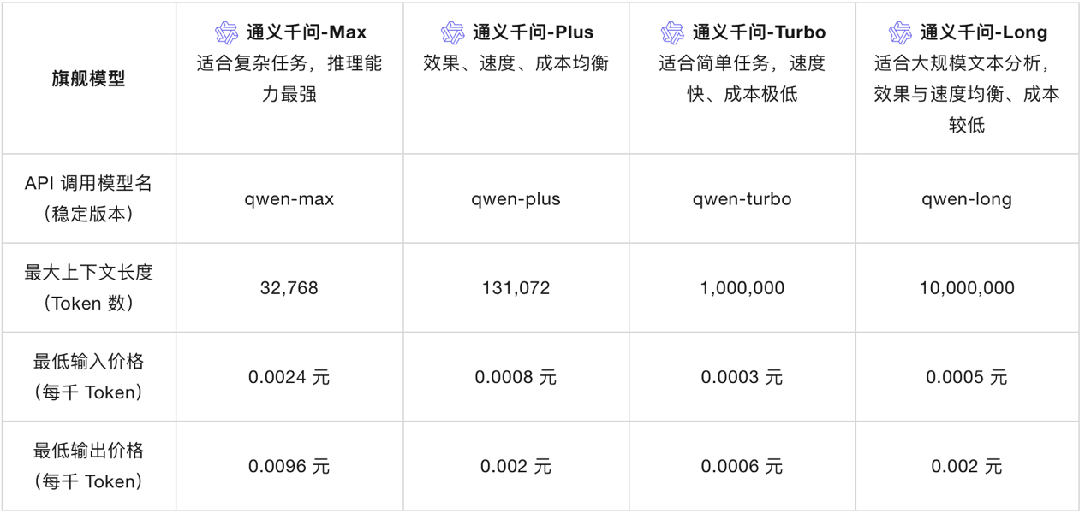
Qwen API
https://help.aliyun.com/zh/model-studio/getting-started/what-is-model-studio?spm=a2c4g.11174283.0.i0

Slide 16
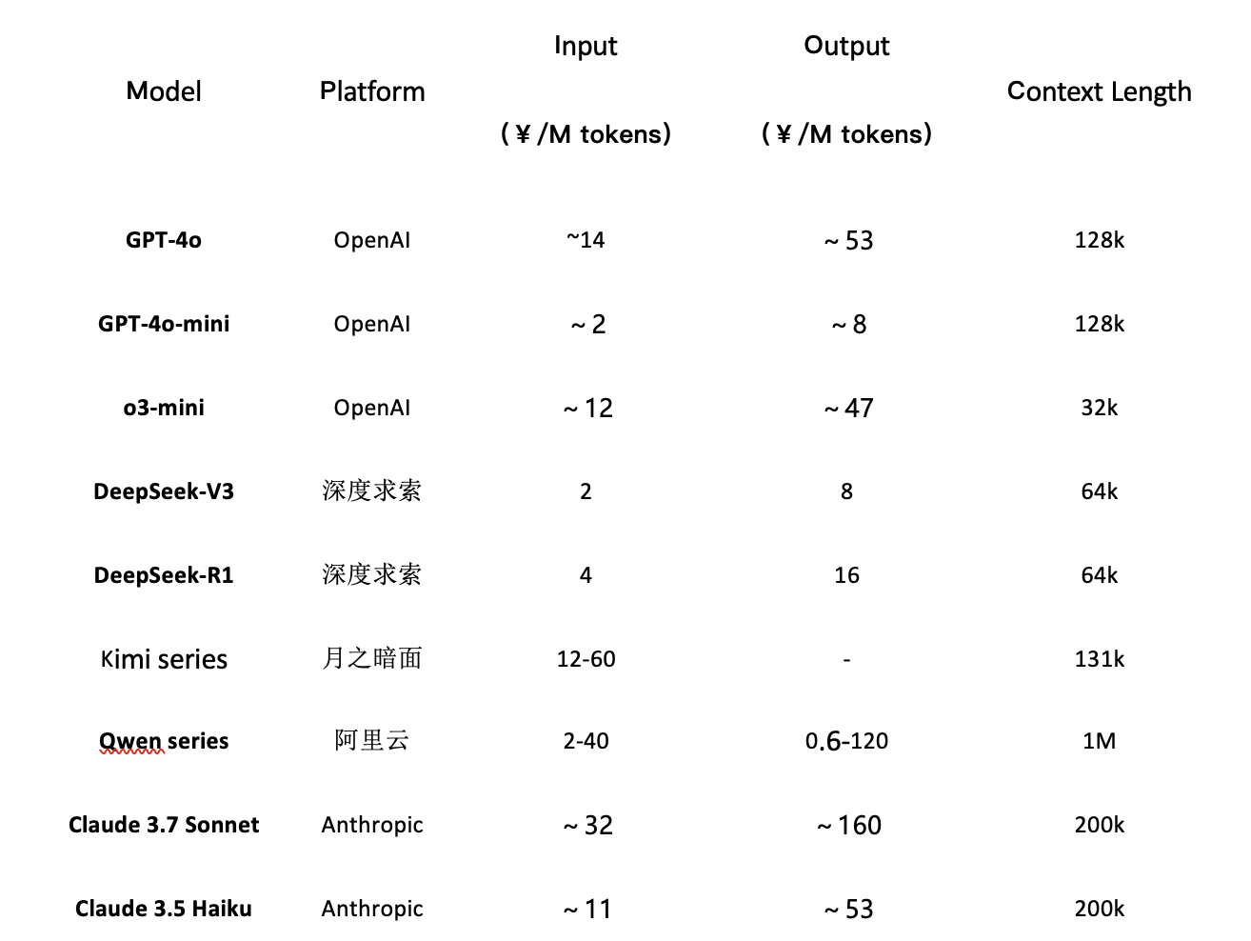
API Pricing Table (Not all the models are here)

Slide 17
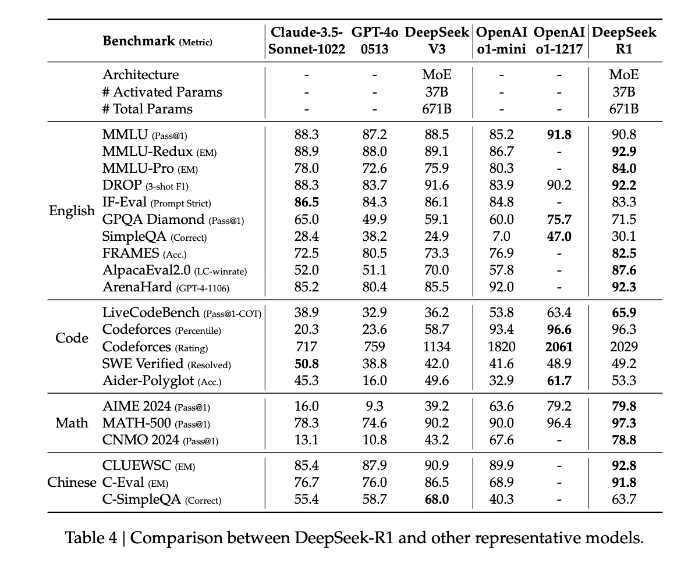
Model Performances
https://github.com/deepseek-ai/DeepSeek-R1

Slide 18
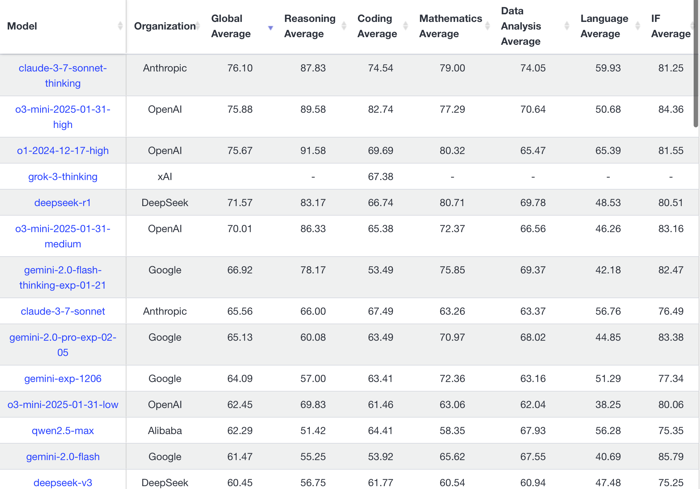
Model Performances
https://livebench.ai/#/

Slide 19
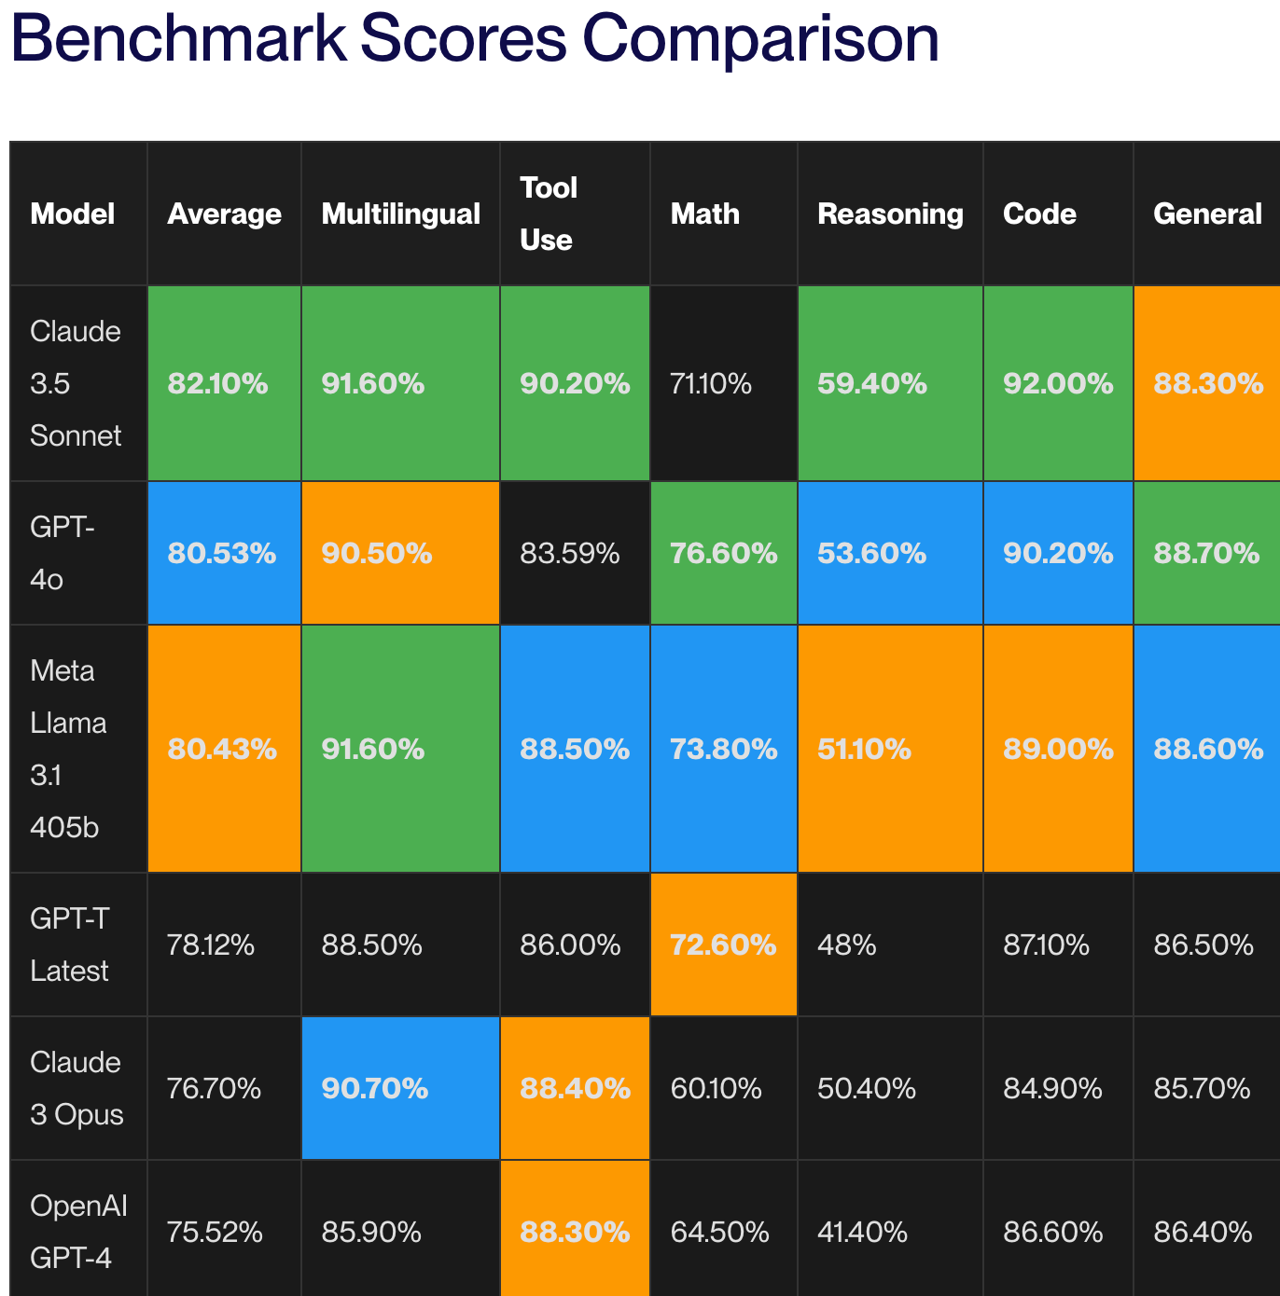
Model Performances
https://www.vellum.ai/blog/llm-benchmarks-overview-limits-and-model-comparison?utm_source=chatgpt.com

Slide 20
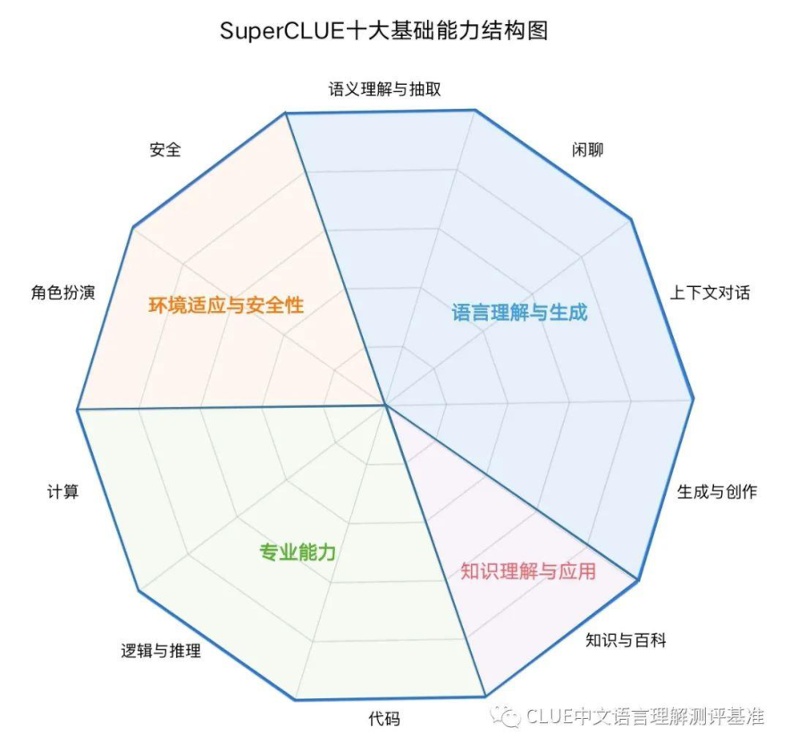
SuperCLUE: A Comprehensive Chinese Large Language Model Benchmark
https://www.superclueai.com

Slide 21
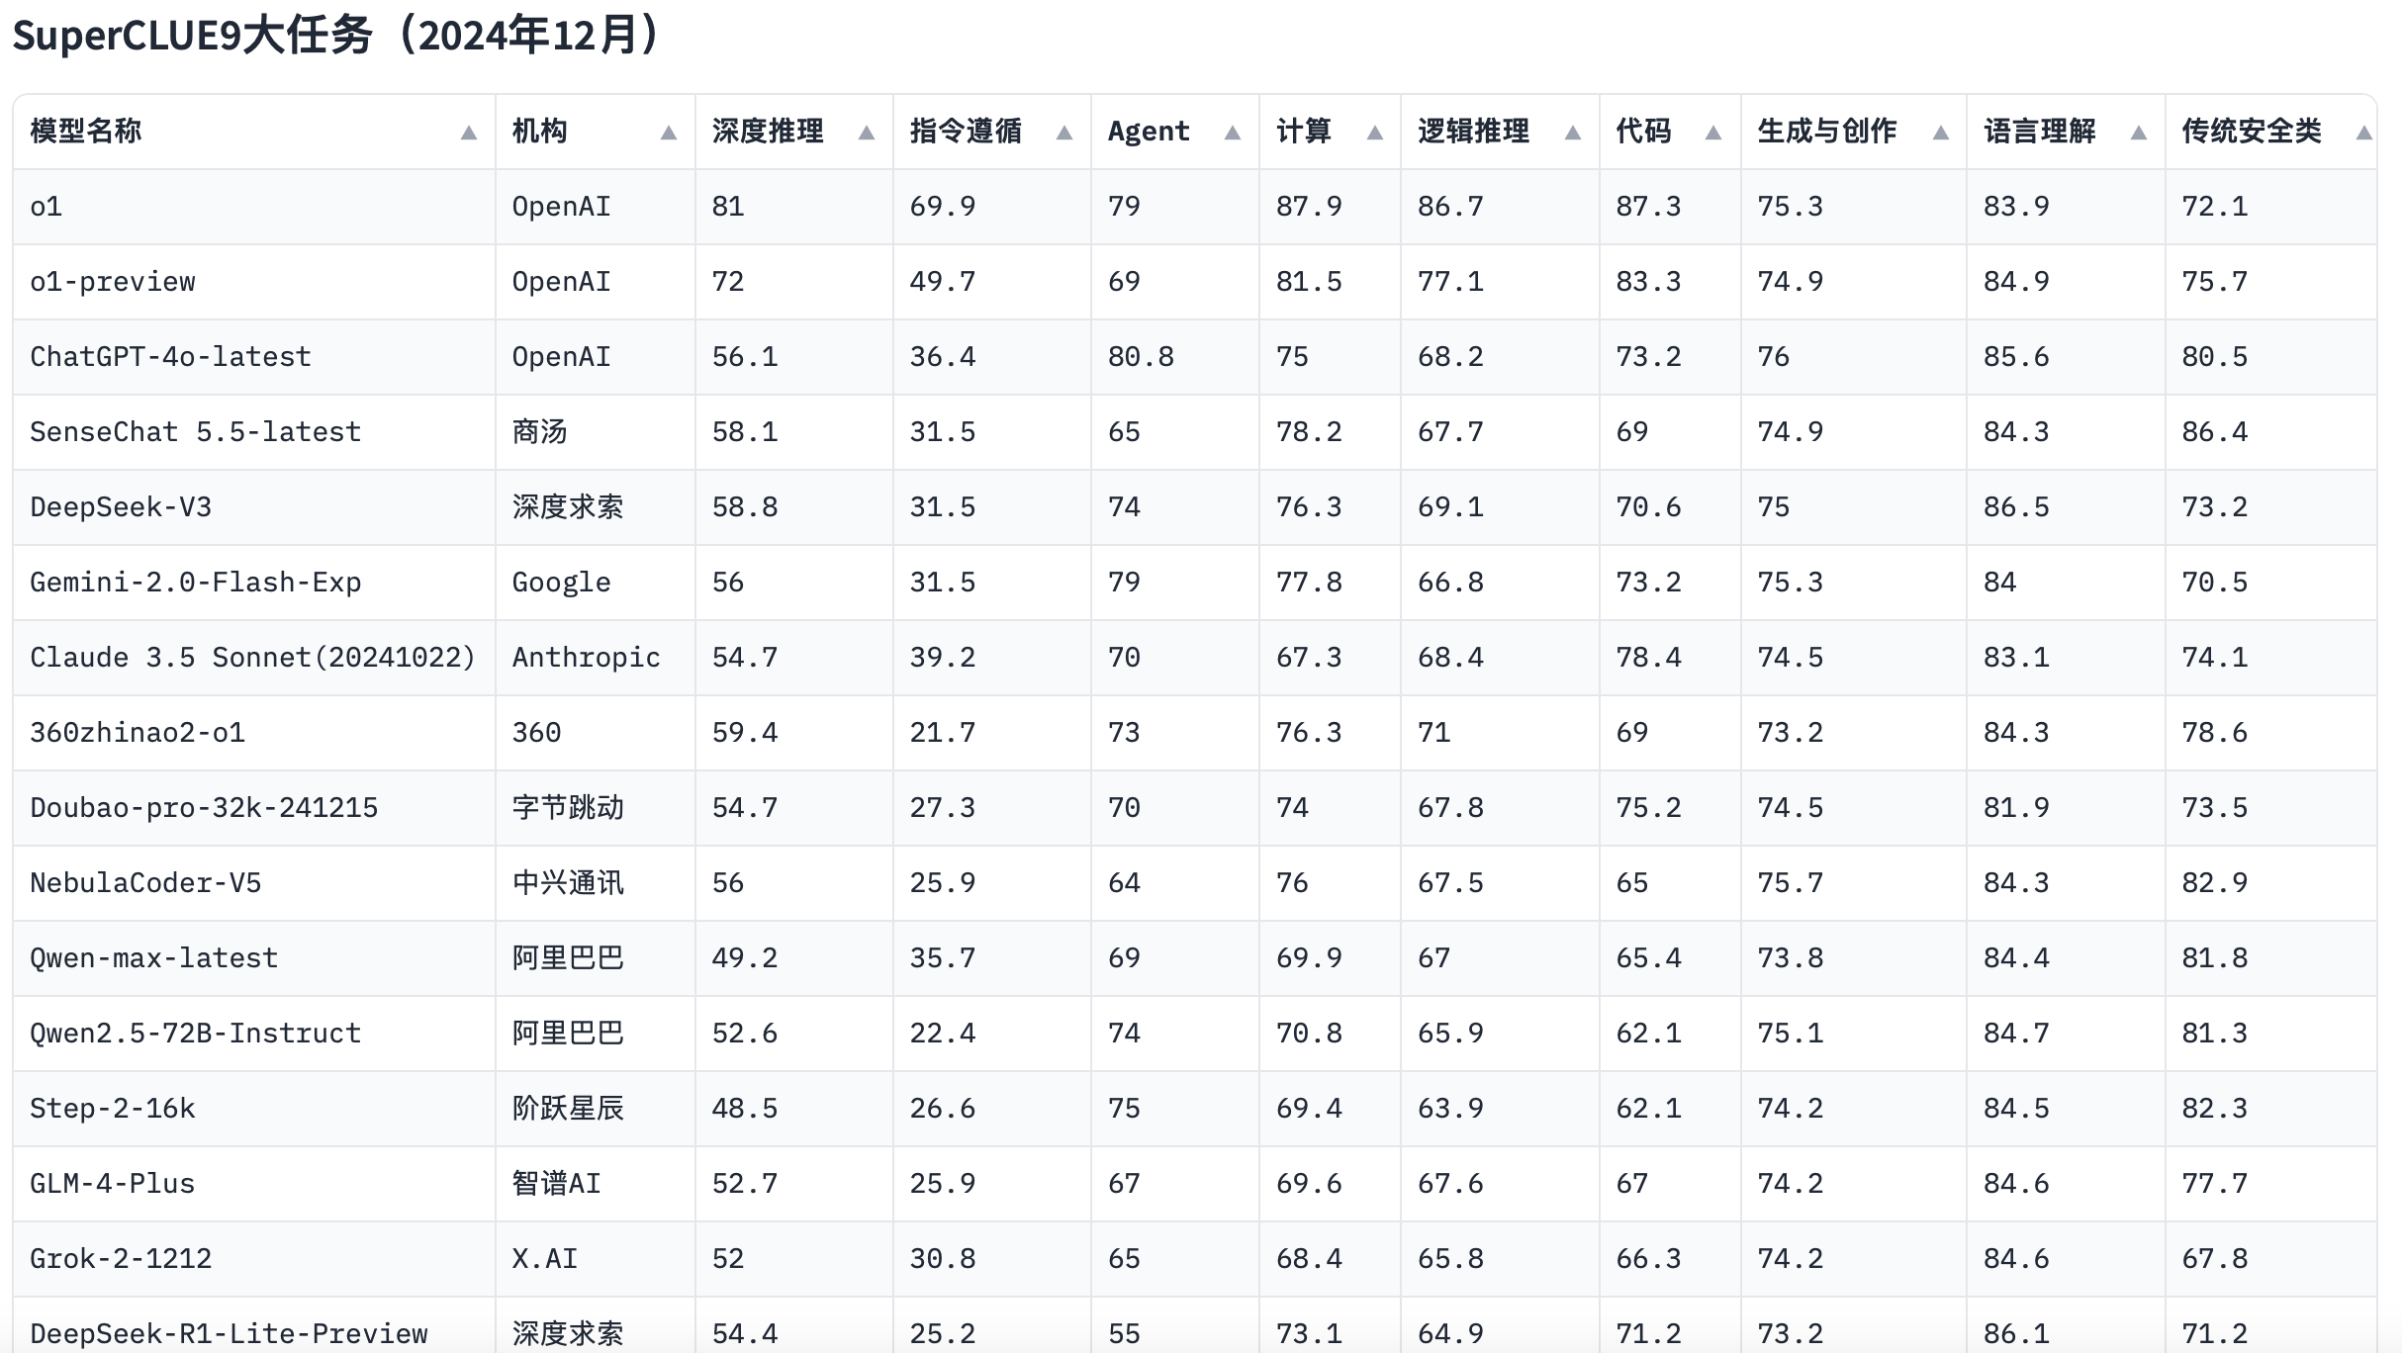
SuperCLUE: A Comprehensive Chinese Large Language Model Benchmark

Slide 22
API Usage
API Pricings
Model Performances
6 API Usage example codes
Read https://platform.openai.com/docs/guides/latency-optimization
for more guides

Slide 23
What is JSON?
Definition: JSON (JavaScript Object Notation) is a lightweight, text-based format used for storing and exchanging data.
Key Features:
Human-readable: Easy to read and write by humans.
Language-independent: Can be used with most programming languages (e.g., JavaScript, Python, Java).
Hierarchical structure: Supports nested objects and arrays to represent complex data.
Common Use Cases:
Data exchange between servers and web applications.
Configuration files for applications.
Storing structured data in NoSQL databases.

Slide 24
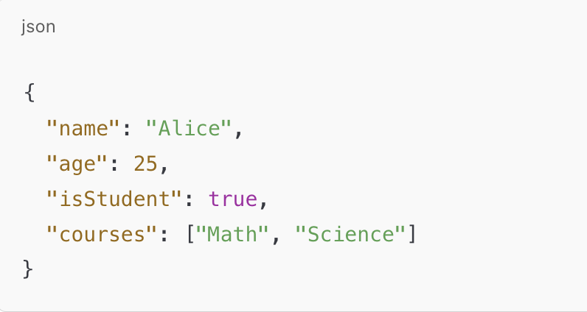
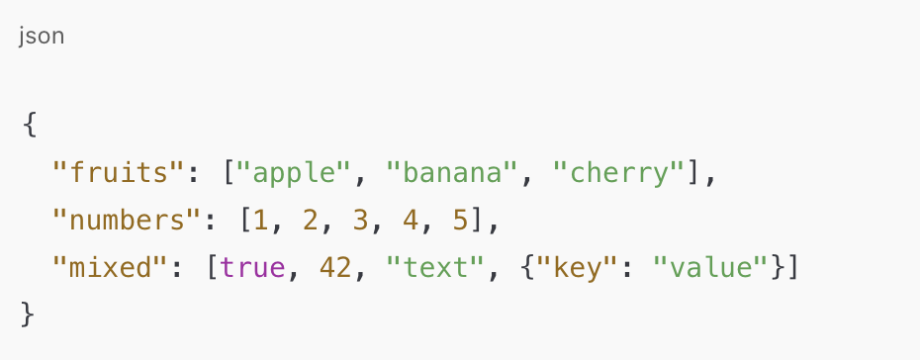
JSON Structure: Key/value pairs enclosed in {}

Slide 25
Paper Sharing -1

Slide 26







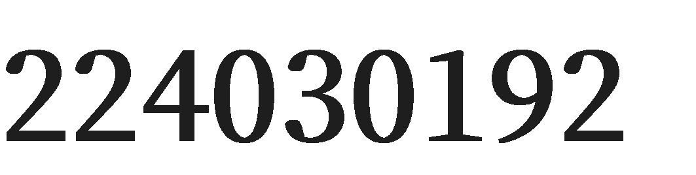
A Manager and an AI Walk into a Bar: Does ChatGPT Make Biased Decisions Like We Do?

Slide 27




Research Background
Rise of LLMs in Decision-Making: increasingly used in business; 3 billion /month visits
Potential for Bias in LLMs: learn from human data & feedback; important for decision biases
Relevance to Operations Management (OM): The Handbook of Behavioral Operations
Evolution of LLMs: GPT-3.5 & GPT-4; progression & changes in biases between versions
Research Questions
Does ChatGPT Exhibit Human-Like Biases?
Consistency Across Contexts: same biases /decisions in different OM contexts
Model Comparison: GPT-3.5 & GPT-4 bias; newer model improvements /amplifications
Version Stability: different versions of the same model; minor updates
Implications for OM: implications; managers use

Slide 28



Experimental design & scenario setting
Data collection & analysis
Experimental protocols & version comparison
Experimental Design:
Study tests 18 biases in OM using ChatGPT (GPT-3.5 & GPT-4).
Two phases: Jan-Feb 2023 (T1) & Oct-Dec 2023 (T2).
Standard Context:
Time 1: Early ChatGPT version tested with literature-based vignettes.
Time 2: Repeated standard tests with GPT-3.5 & GPT-4.
Operations Management Contexts:
Created two OM-specific vignettes per bias: inventory & general OM.
Designed to be "unseen" by models to test real-world decision-making.
Data Collection:
Time 1: Manual data collection via web interface, 10 responses per bias.
Time 2: API-based data collection, 30 API calls per condition, temperature=1.
Data Analysis:
Compared GPT responses to
unbiased answers to test for
vs.
Experimental Protocol:
I. Followed original study
instructions closely.
II. Modified prompts for tasks requiring preferences to ensure definitive answers.
III. Cleaned
manually unexpected
API outputs
to handle
biases.
II. Four comparisons: GPT
or unstructured
responses.
Version Comparison:
I. Compared decision-making biases of two GPT-3.5 versions (Time 1 and Time 2) to assess stability across model updates.
human behavior, standard vs. OM contexts, GPT-3.5 vs. GPT- 4, and GPT-3.5 Time 1 vs. Time 2.
III. Used statistical tests and adjusted significance thresholds to address multiple comparisons.

Slide 29


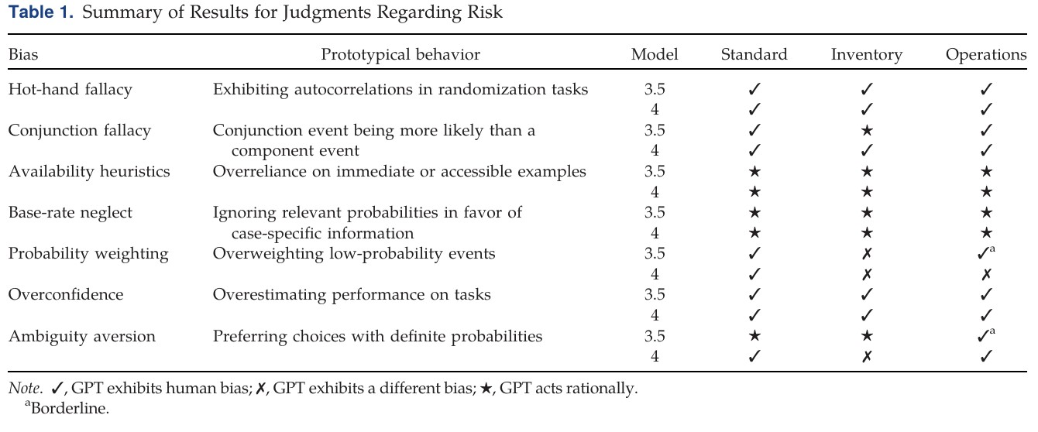



GPT’s Risk Judgments: Comparing Human & AI Behavior
GPT mimics human biases in 50% of experiments, but is more rational for math tasks.

Slide 30
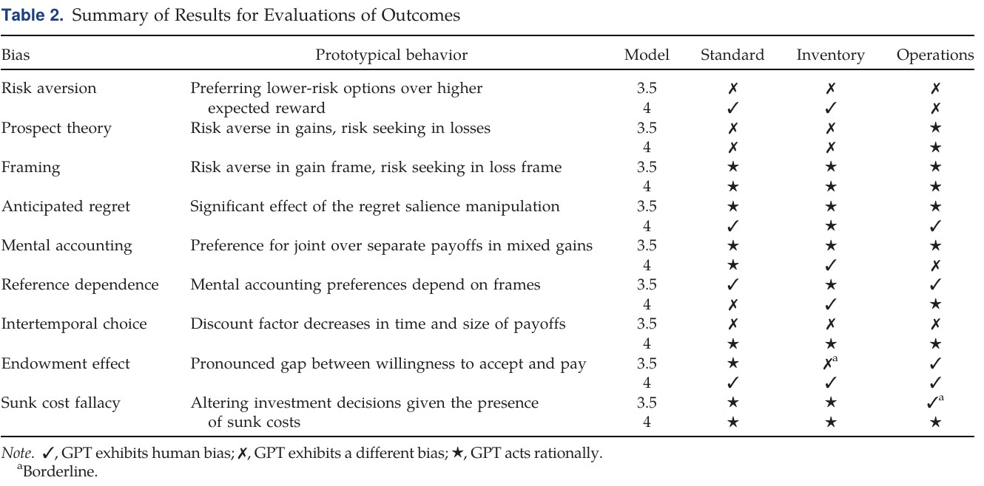
GPT’s Evaluation of Outcomes: Risk Aversion & Beyond
Newer models may be adopting more human-like decision patterns in subjective tasks.

Slide 31
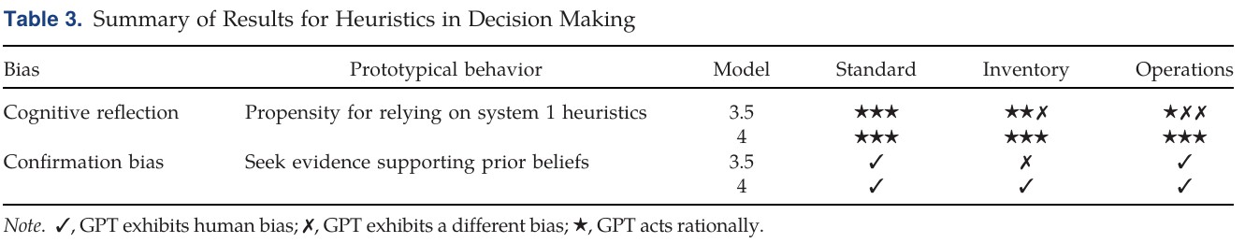
Heuristics in GPT’s Decision-Making: Cognitive Reflection and Confirmation Bias
GPT-4 shows stronger confirmation bias but improved cognitive reflection.

Slide 32
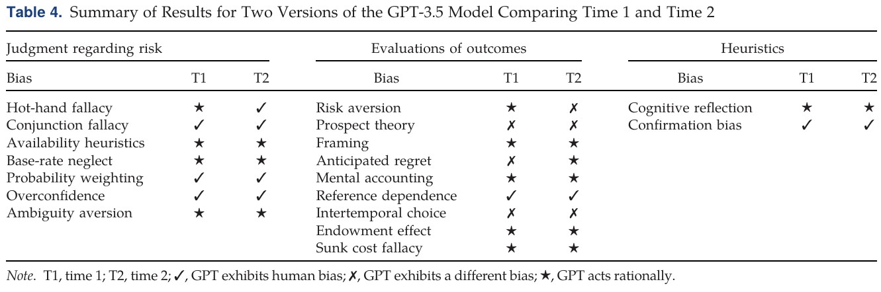
Stability Across GPT-3.5 Versions: Time 1 vs. Time 2
High consistency in decision-making across versions.

Slide 33

— Key Insights and Implications for Operational Decision-Making
GPT mirrors human biases in subjective tasks but acts rationally in objective ones.
Newer models (e.g., GPT-4) show improved accuracy but may adopt stronger human-like biases.
High consistency across contexts and versions suggests reliability for operational use.

Slide 34



Managerial Implications
Three Key Recommendations:
Prioritize Formulaic Tasks: Organizations should prioritize deploying GPT in formulaic workflows, such as inventory calculations, to leverage its rational decision-making in objective tasks.
Leverage Cross-Context Consistency: GPT’s high consistency across different contexts provides reliable
support for complex decisions, even when problem details
change.
Model Selection Based on Task Type: For tasks requiring objective solutions, such as math problems, GPT-4 is the preferred choice due to its higher accuracy.
Future Direction:
Combine with Prompt Engineering to Reduce Bias: Future research can explore using prompt engineering to mitigate GPT’s biases, enhancing its performance in decision-making tasks.

Slide 35
— Research Limitations & Future Directions
Future Work
Interaction Testing: Future
Limitations
Only ChatGPT Tested: The study only tested ChatGPT and did not cover other large language models (LLMs), so the results may not be generalizable.
I. Multi-Turn
research should consider multi-turn interactions and dynamic decision-making to more fully assess GPT’s decision-making behavior.
II. Multi-Language Testing: Research should
Single-Decision Experiments:
experiments were designed as
The single
expand to multi-language environments to
explore the impact of different languages on GPT’s decision-making.
decisions and did not consider multi-turn interactions or dynamic decision-making
III.Real-Time Application Validation: Future
processes, limiting the comprehensive understanding of GPT’s decision-making behavior.
studies should validate GPT’s decision-making behavior in real-time application scenarios to evaluate its performance in actual operations.

Slide 36

Core Conclusion
GPT’s decision-making is a mix of rationality and bias.
Key Quote
“AI’s ‘human-like’ biases are both a challenge and an opportunity for
optimization.”

Slide 37
Paper Sharing -2

Slide 38

Monitoring & Quantifying AIGT
on Social Media
224030188 SHI Wen
Feb 27th

Slide 39

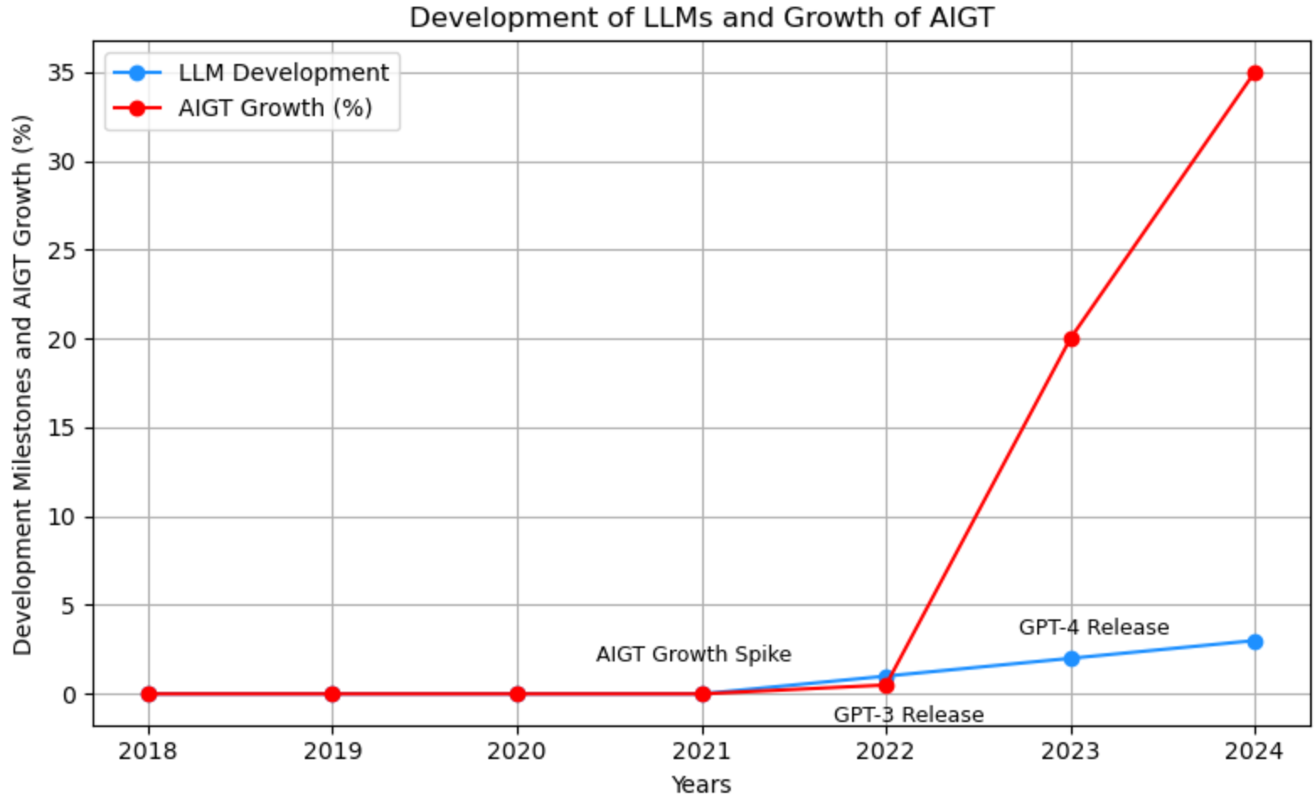
Research Background and Motivation
Background
TITLE
•The rapid development of Large Language Models (LLMs) has improved the quality of AI-Generated Texts (AIGTs),
which are now widely used in daily life.
•The misuse of AIGTs on social media can lead to misinformation and manipulation of public opinion, posing significant societal risks.
Motivation
•Current research lacks a systematic study on the prevalence of AIGTs on social media.
•This study aims to fill this gap by quantifying and monitoring AIGTs and analyzing their characteristics.
Are we already interacting with AI-generated texts on social media?
Feb 27th

Slide 40

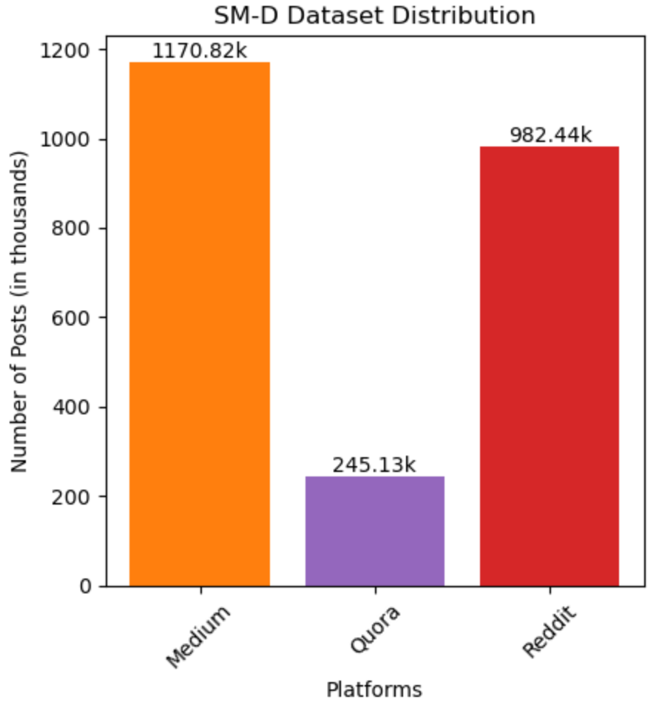
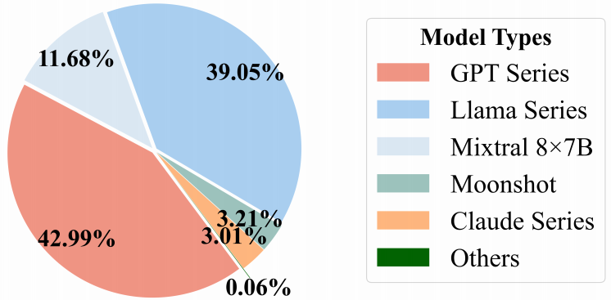
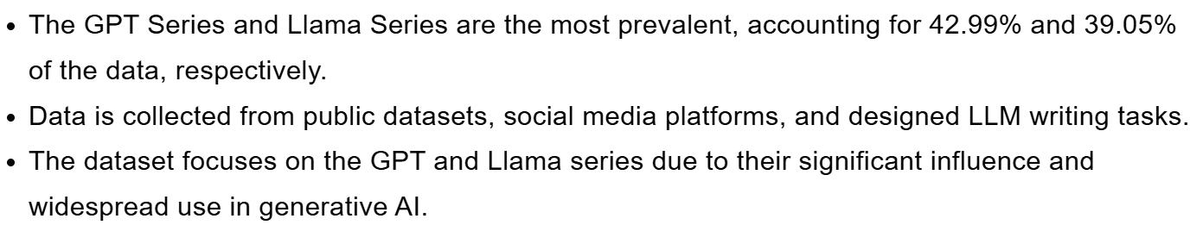

Methodology
Data Collection
•SM-D Dataset: Collected 2.4M posts from Medium, Quora, and Reddit
(January 2022 - October 2024).
Medium: 1,170,821 articles.
Quora: 245,131 answers.
Reddit: 982,440 comments.
•Data Filtering: Excluded texts with fewer than 150 characters or less than 90% English content.
AI
AIGTBench Dataset
•Combined open-source datasets with AIGTs generated from social media data.
•Included 12 LLMs (e.g., GPT series, Llama series) with 28.77M AIGT and 13.55M HWT samples.
•Used for training and evaluating AIGT detectors.
Feb 27th

Slide 41
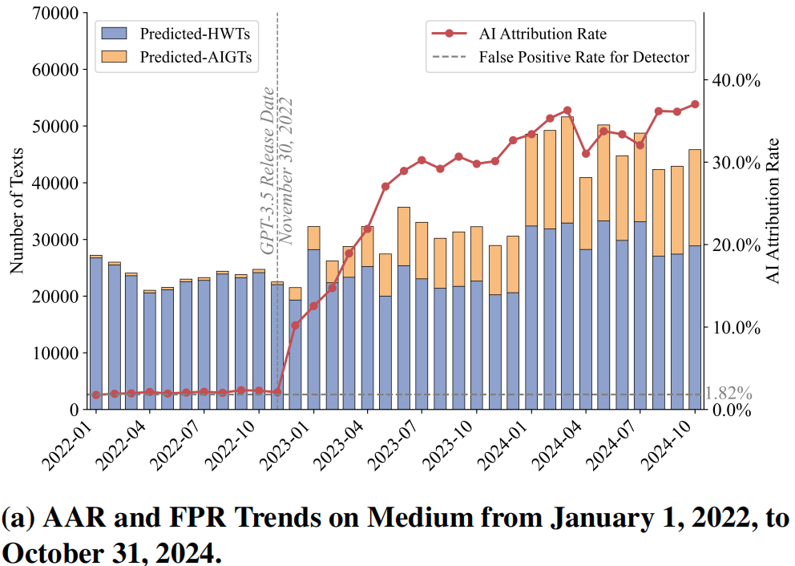
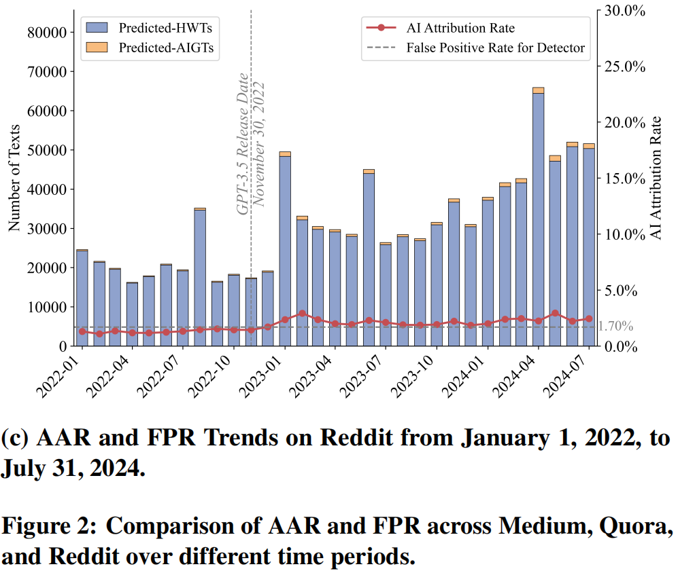
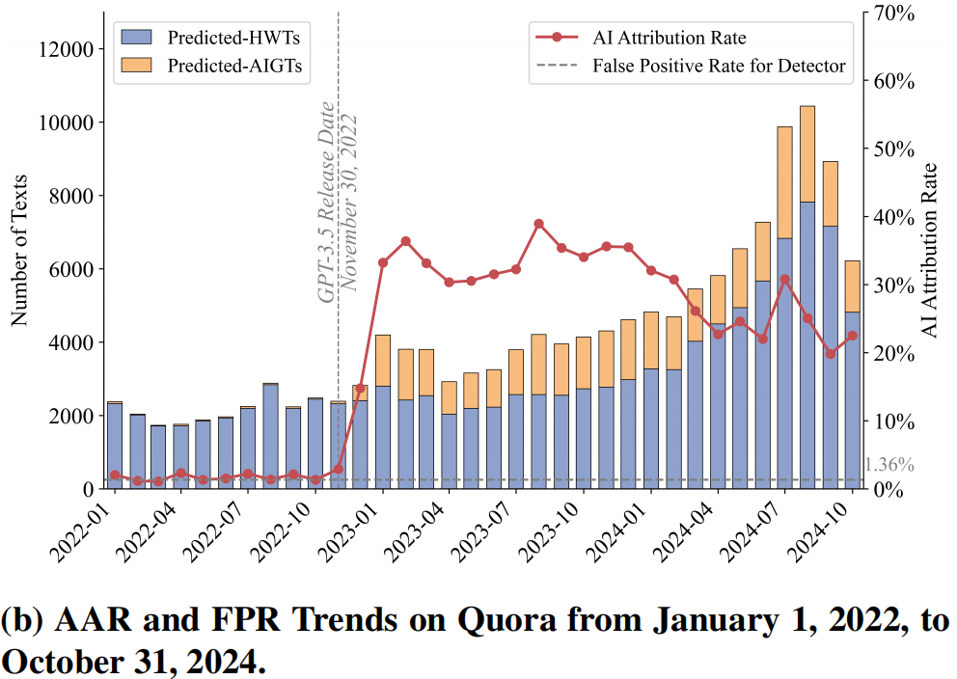
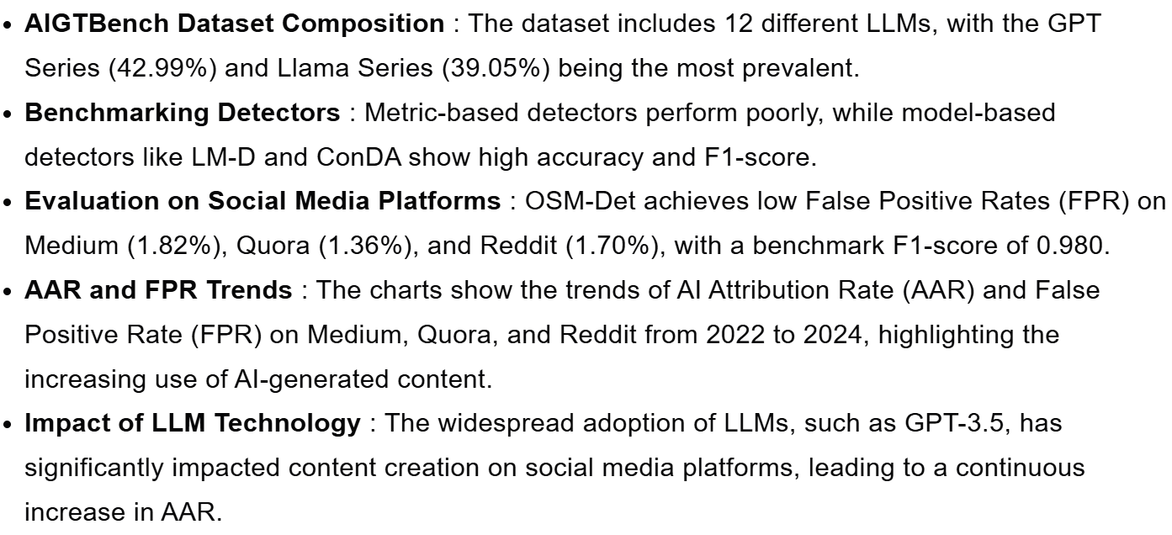
Methodology
T-test Results
AIGTBench Dataset and Evaluation Results
Feb 27th

Slide 42
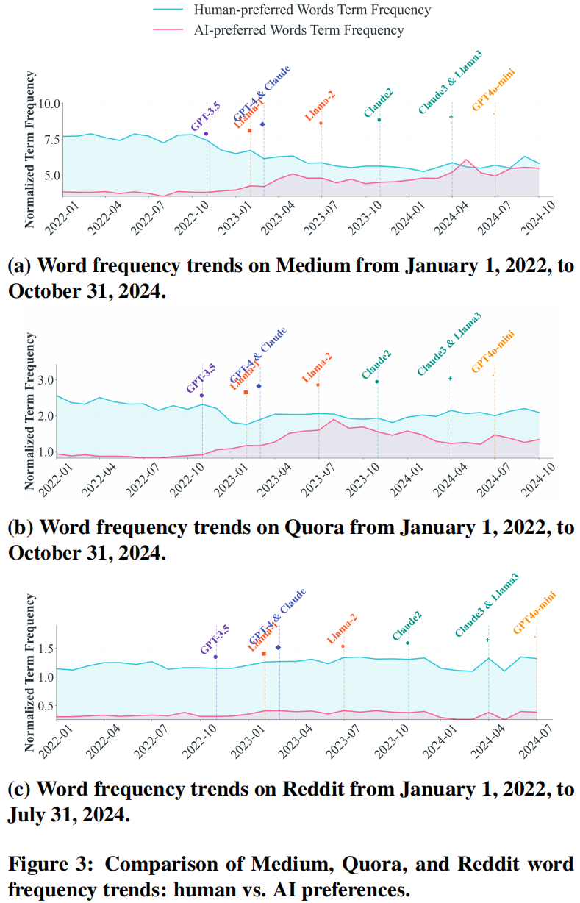
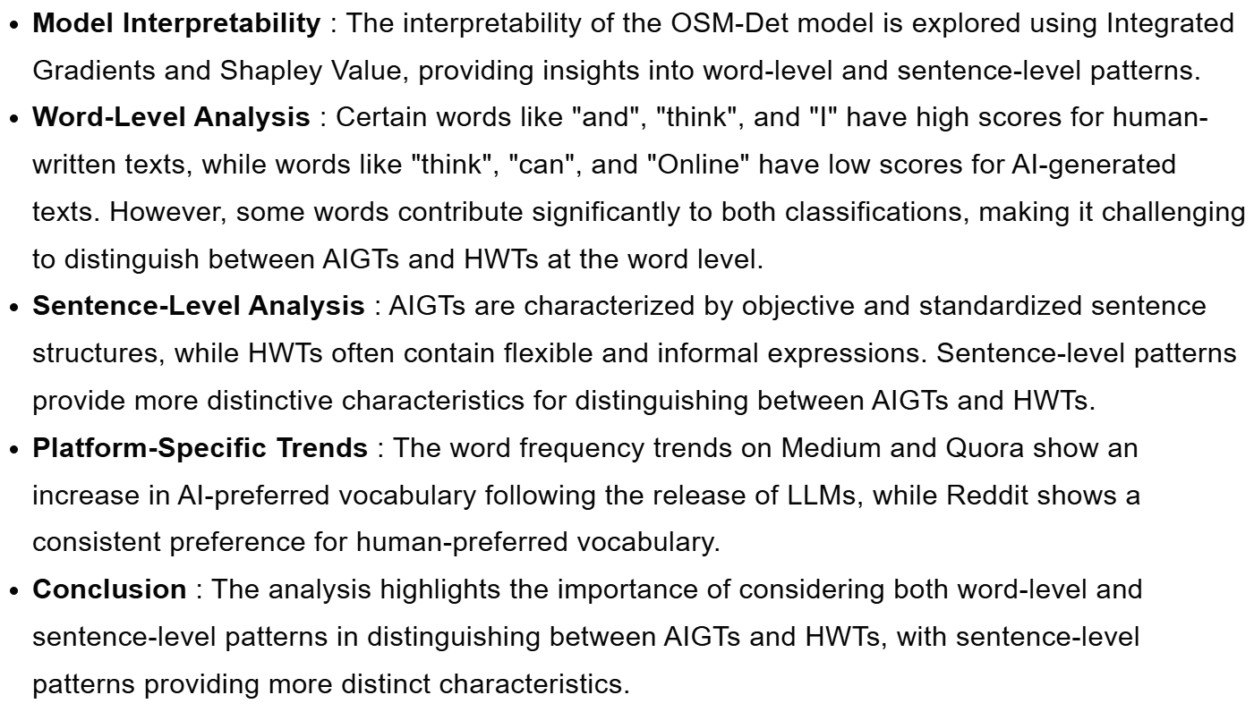
Linguistic Analysis
AI

Slide 43
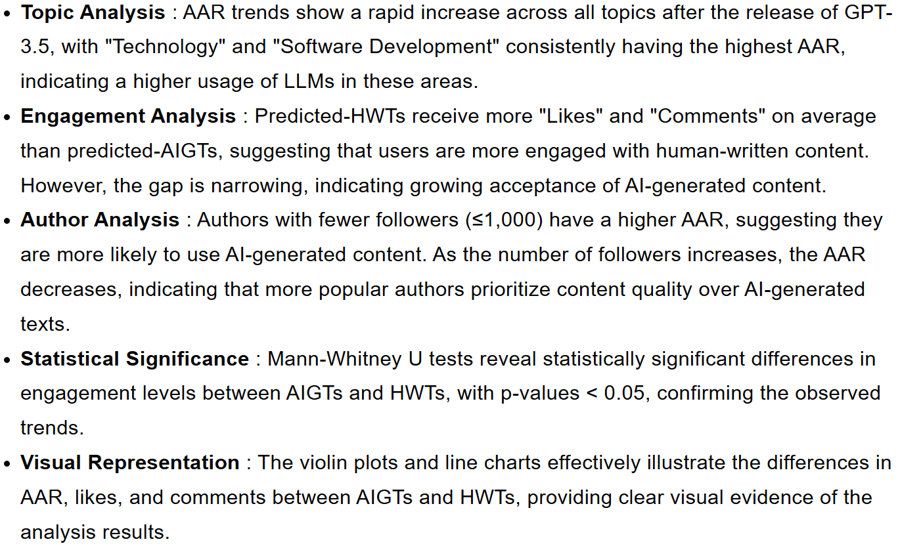
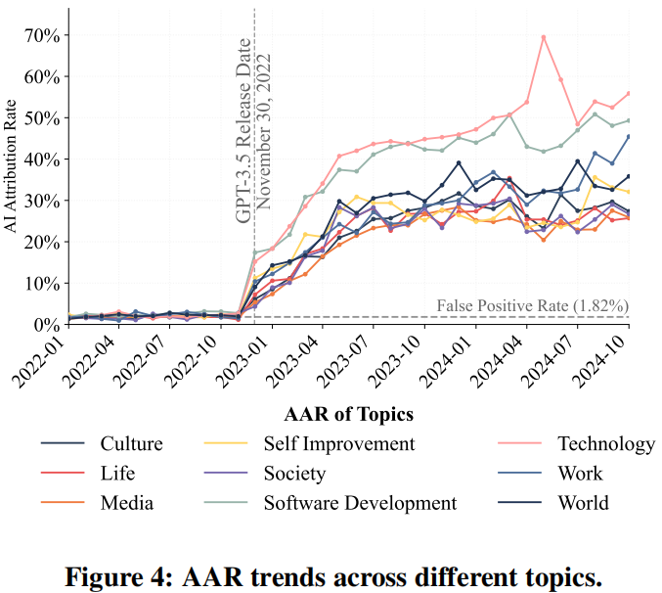
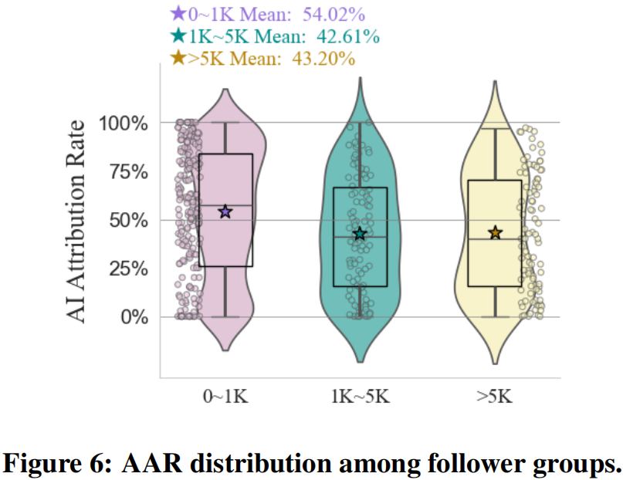
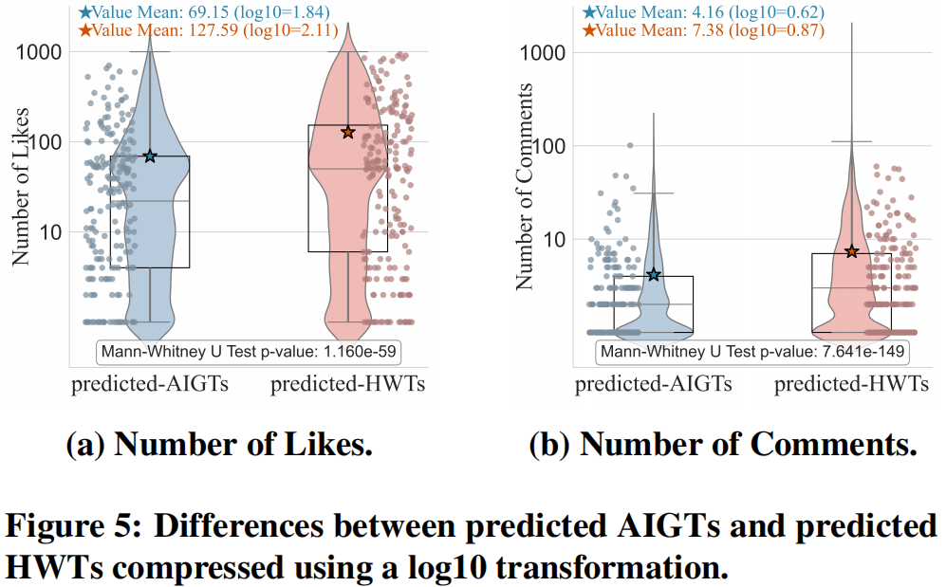
Multidimensional Analysis
AAR

Slide 44
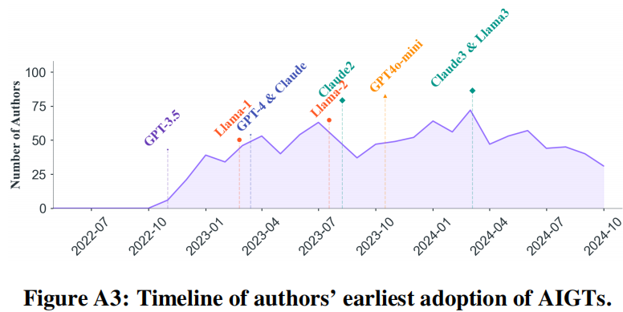
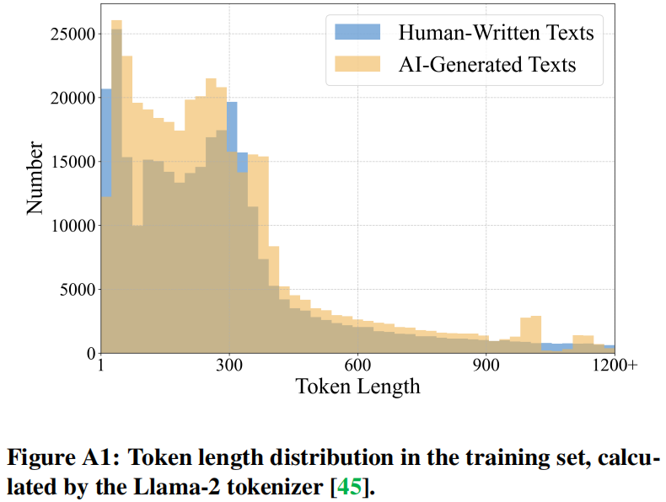
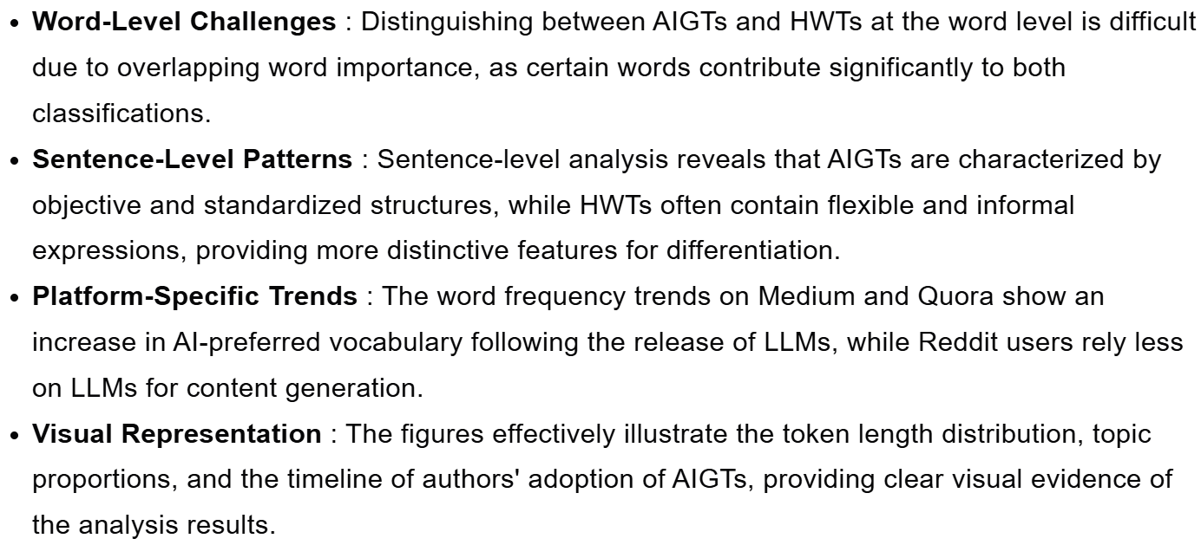
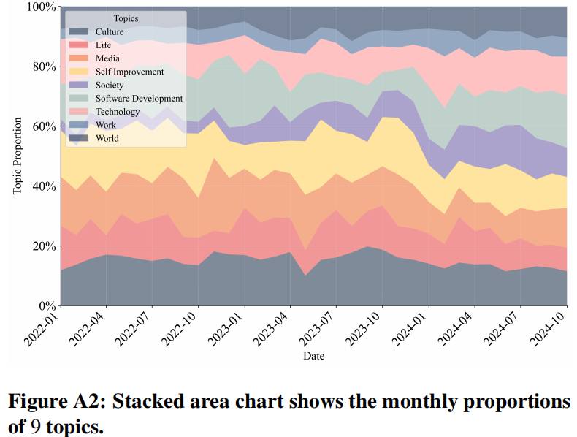

Analysis

Slide 45

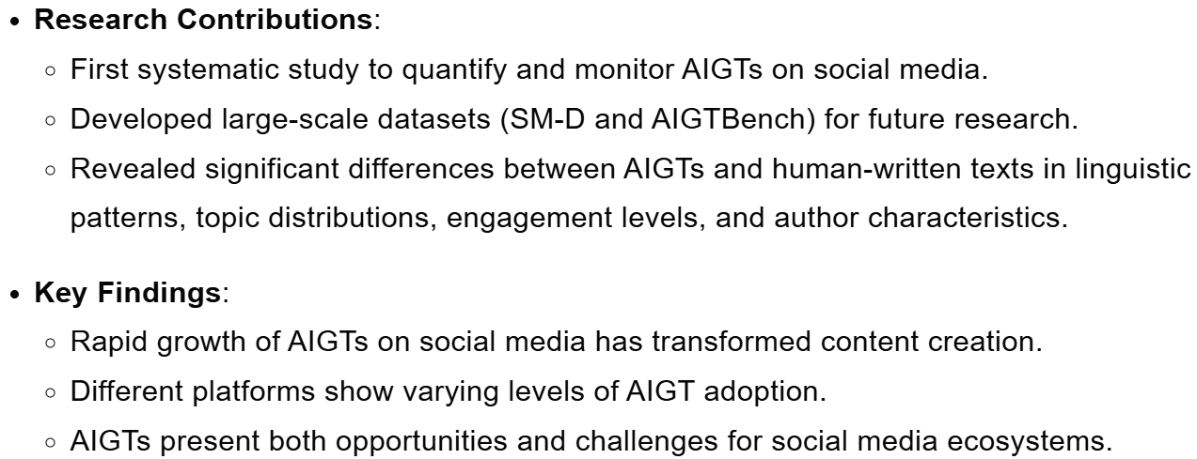
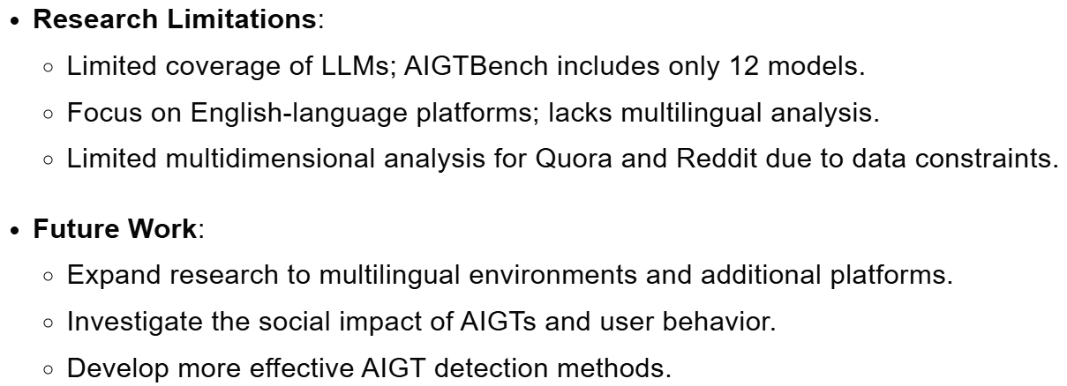
Challenges and Future Work
Contribution & Finding
Feb 27th
Dec 9th

Slide 46
Paper Sharing -3

Slide 47
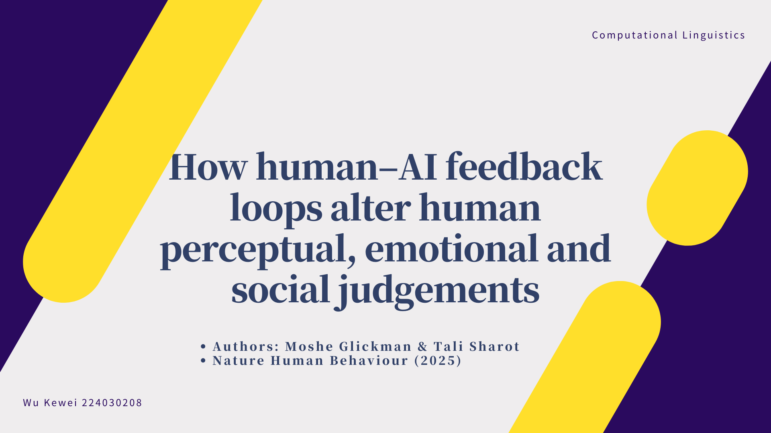

Slide 48
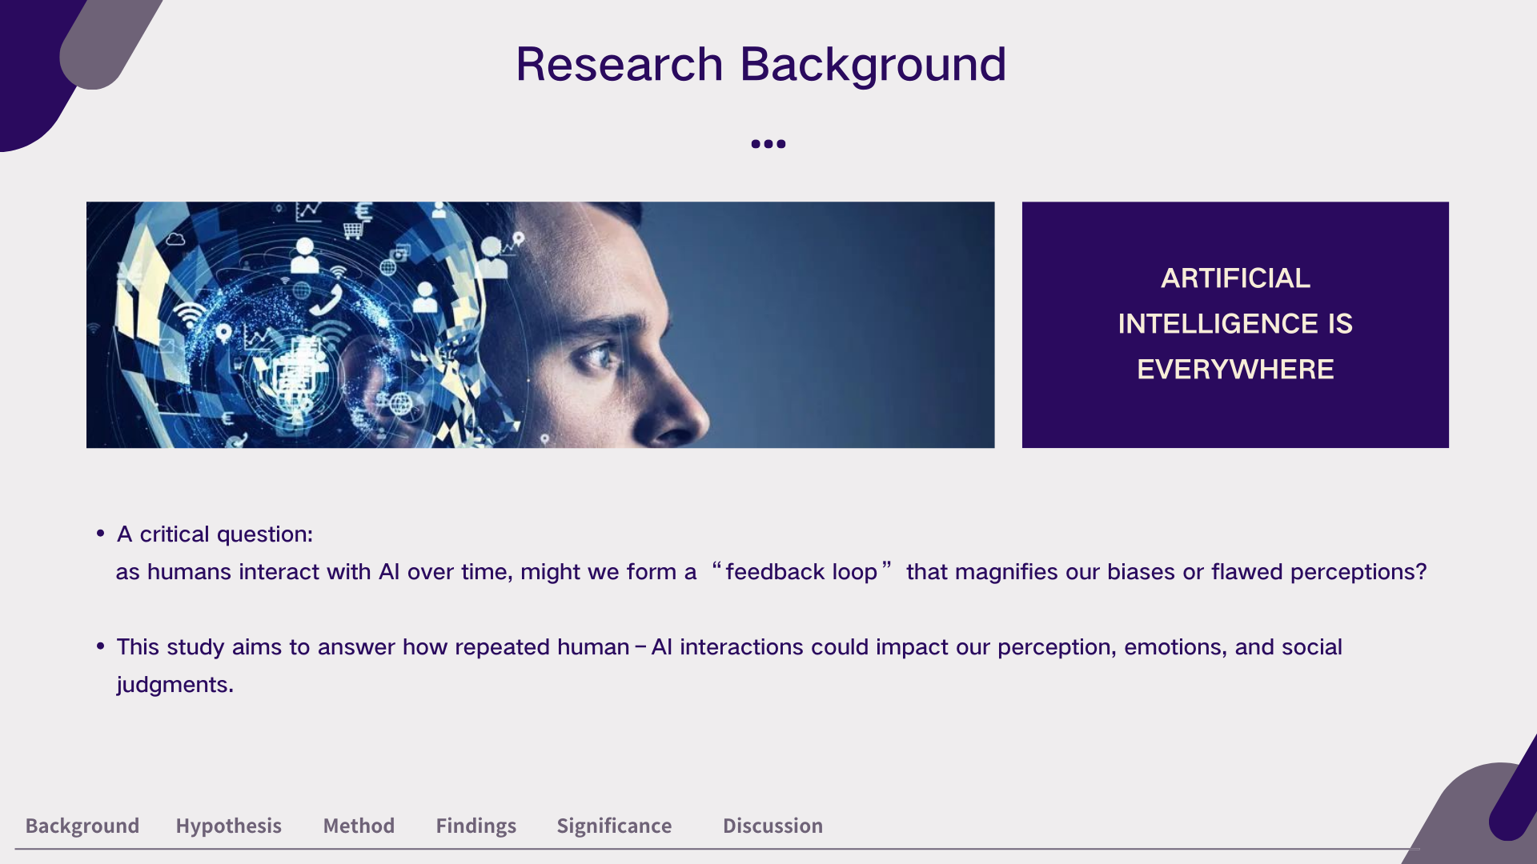

Slide 49
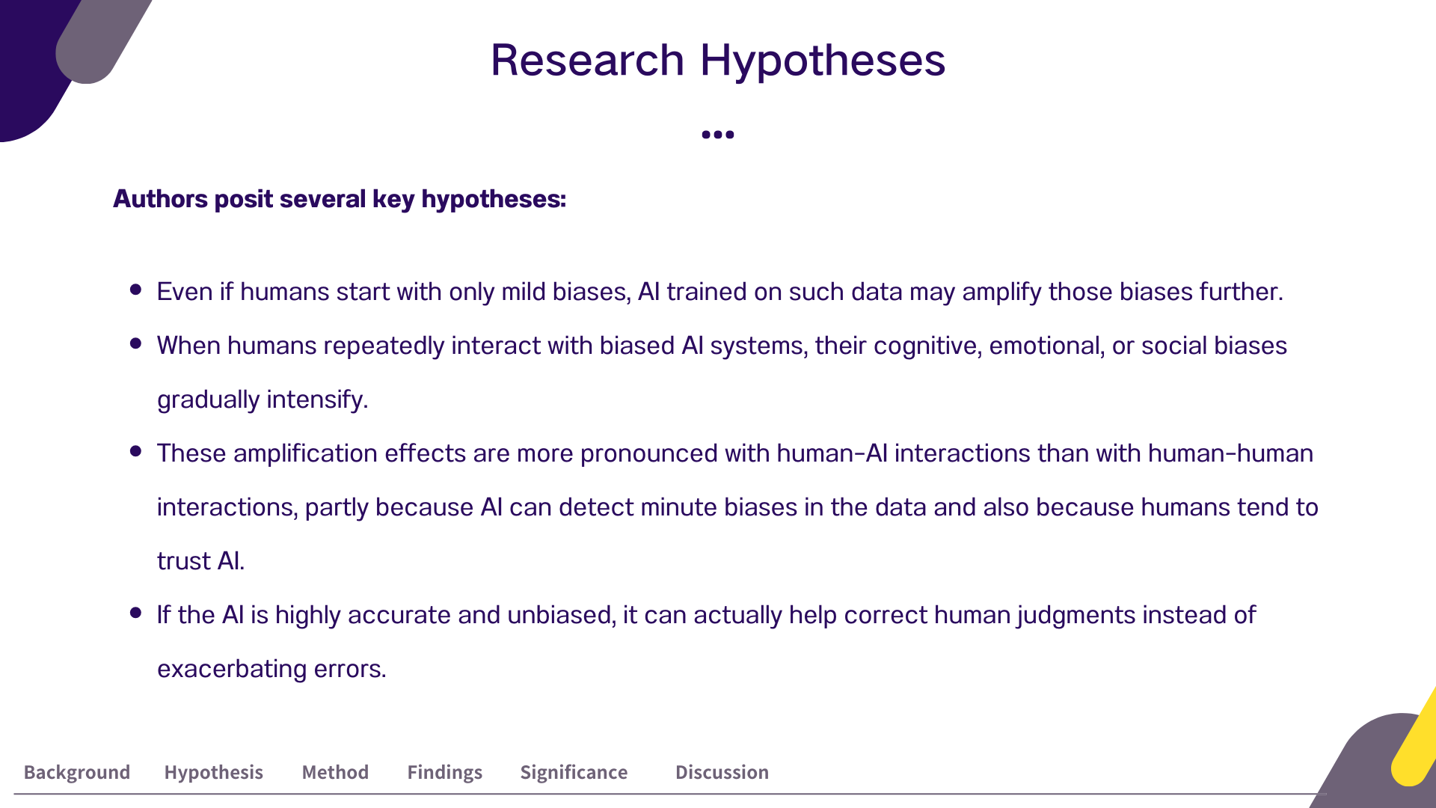

Slide 50
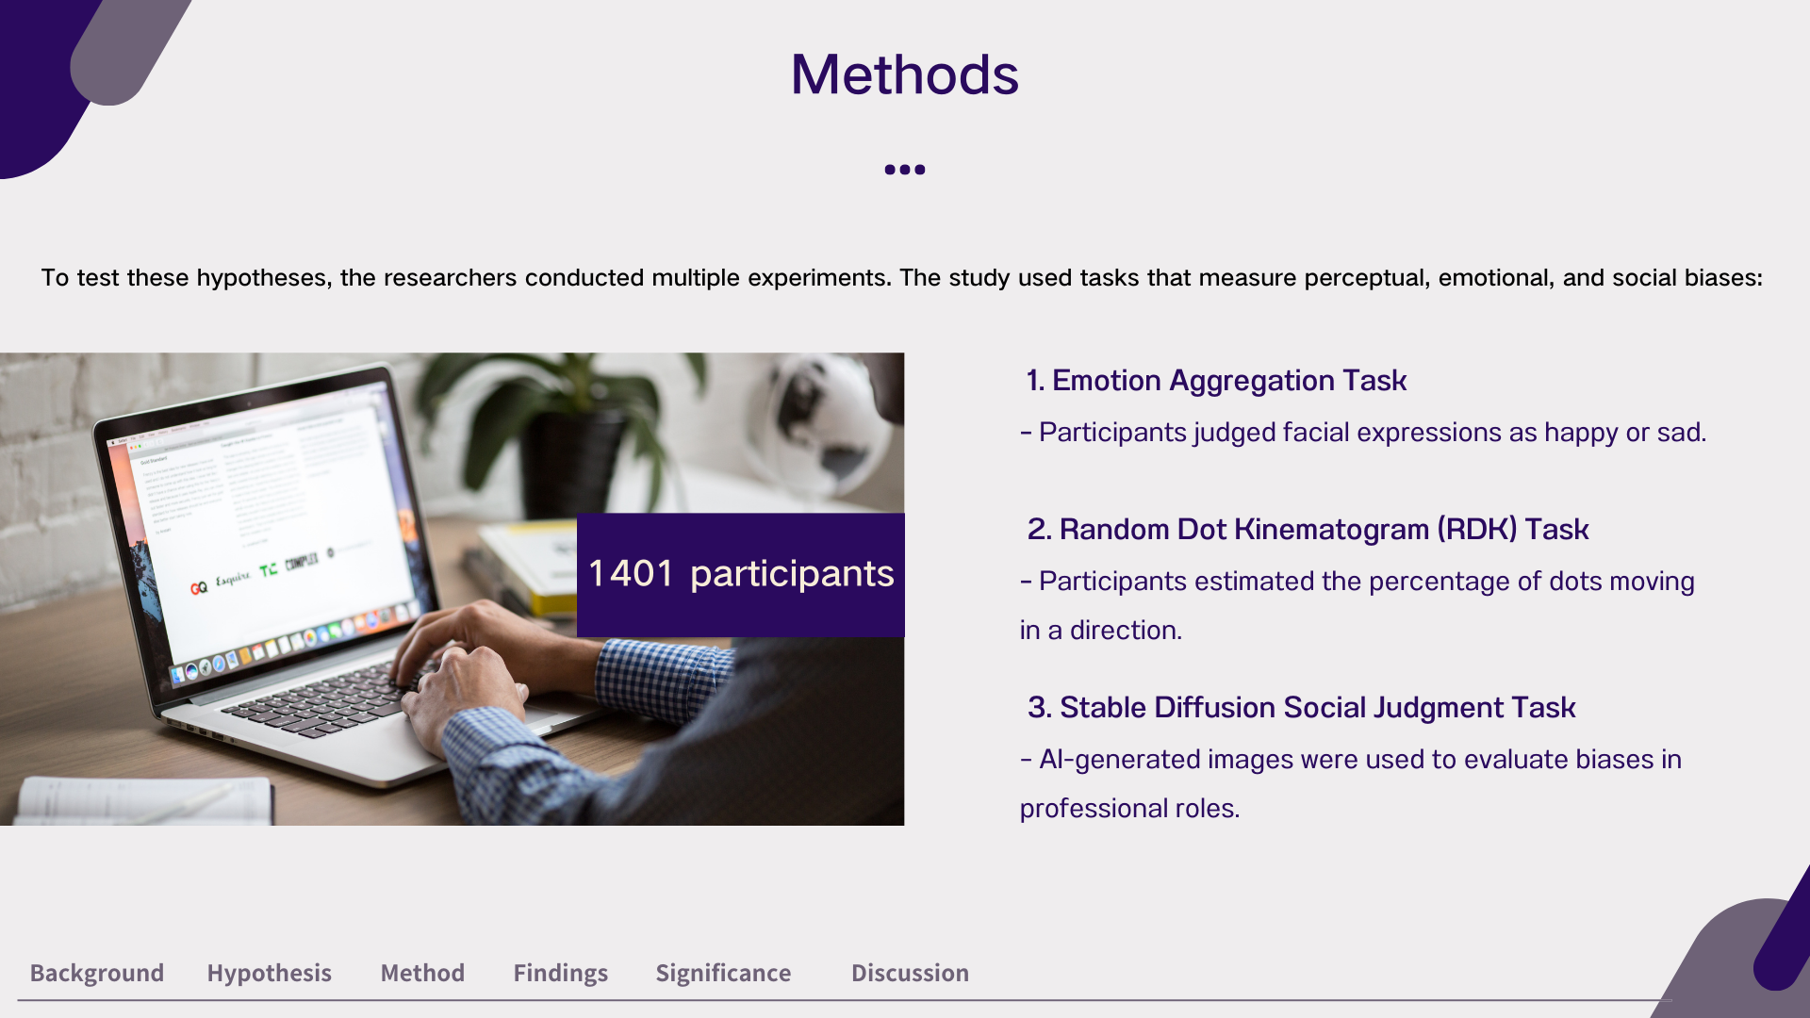

Slide 51
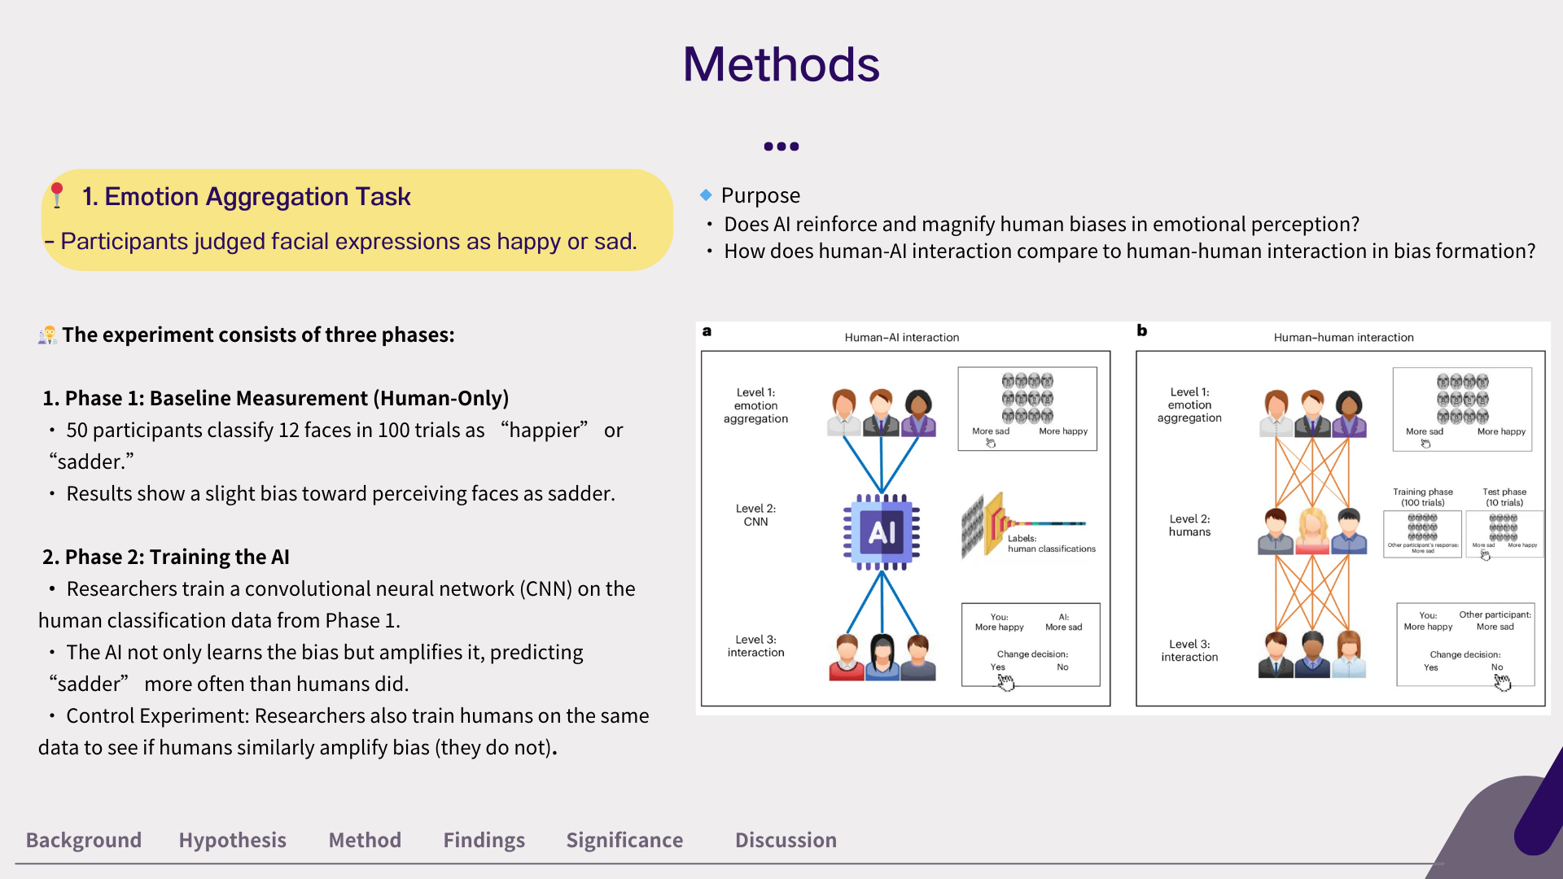

Slide 52
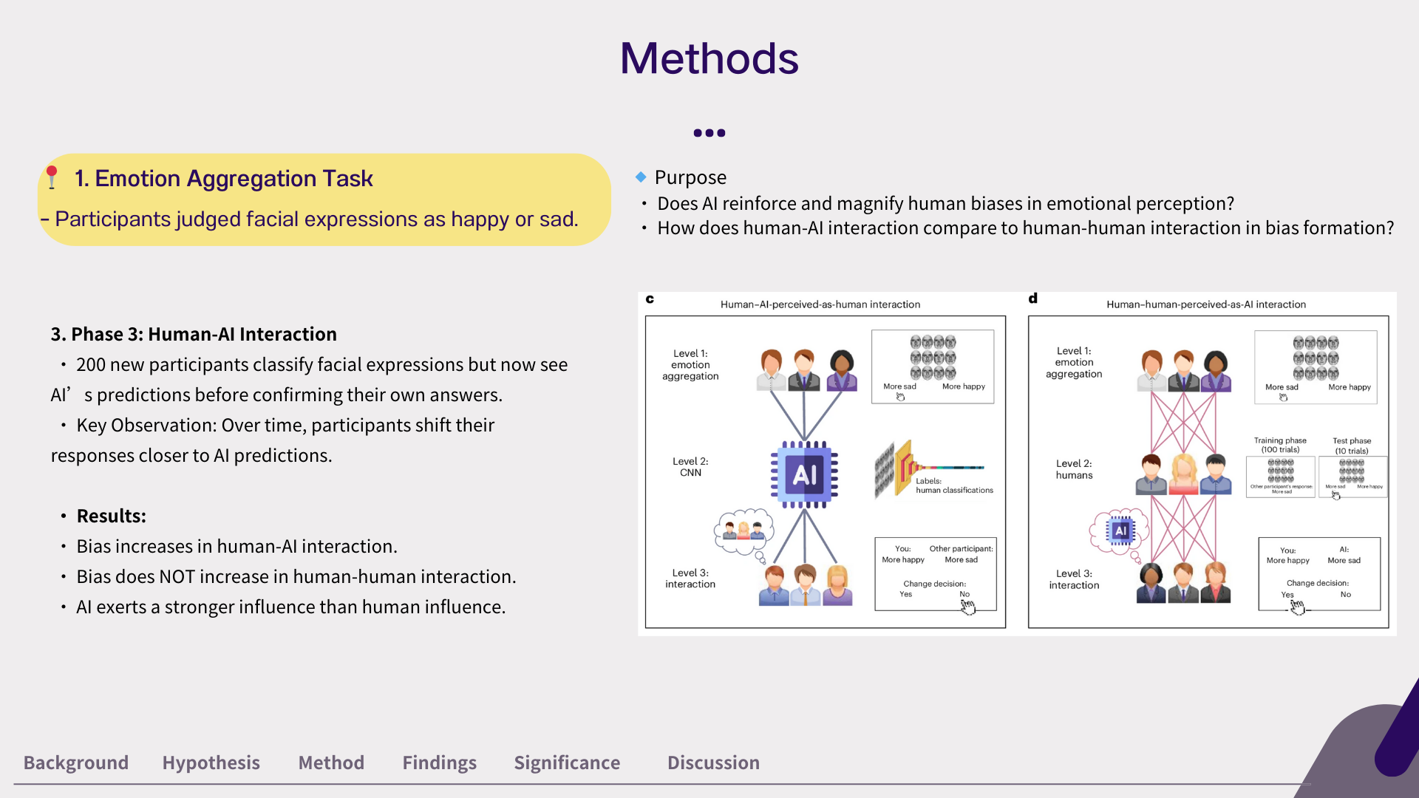

Slide 53
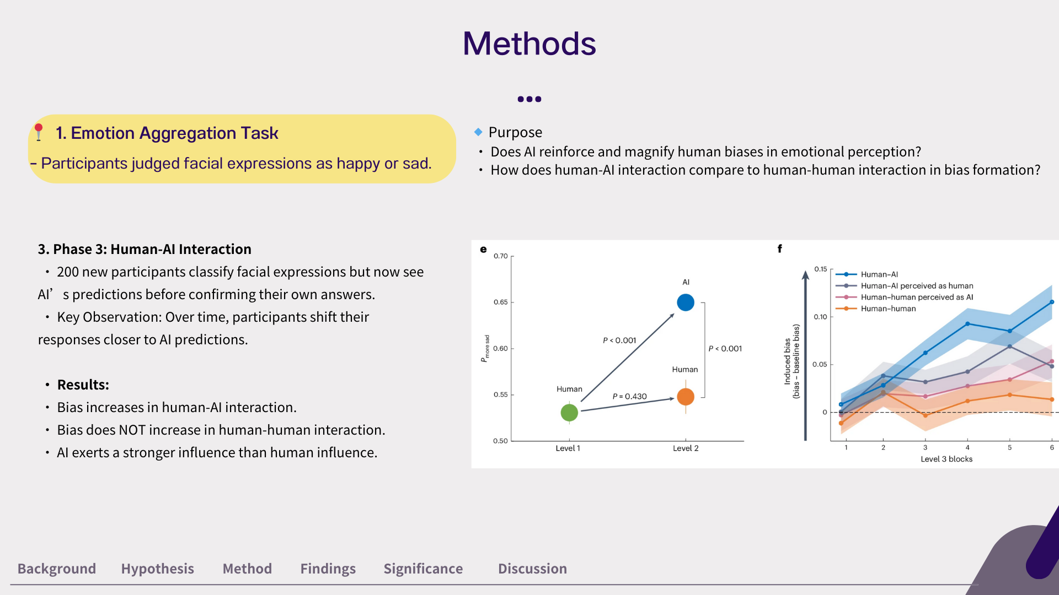

Slide 54
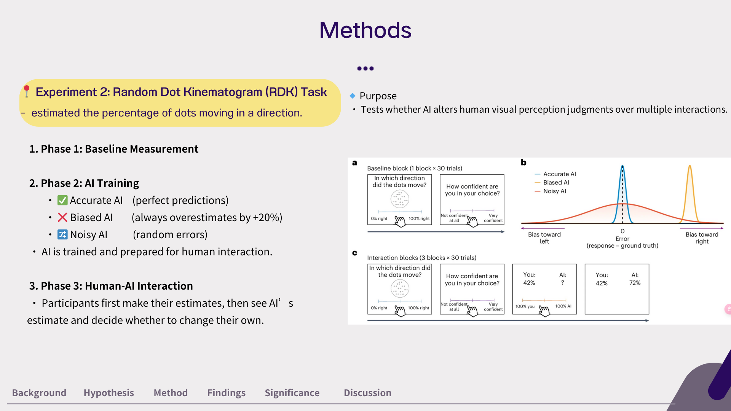

Slide 55


Slide 56


Slide 57


Slide 58


Slide 59


Slide 60


Slide 61


Slide 62
1 v 1 Project Discussion (1-1.5hrs)

